Slide 1
RiTE: Providing On-Demand Data for Right-Time Data Warehousing
(ICDE '08)
Christian Thomsen, Torben Bach Pedersen and Wolfgang Lehner

Slide 2
Agenda
Motivation
The RiTE Package
RiTE Operations:
  Producer Side
  Catalyst
  Consumer Side
Performance
Conclusions
Some ideas borrowed from http://www.inf.unibz.it/dis/research/seminar_slides/pedersen08.pdf

Slide 3
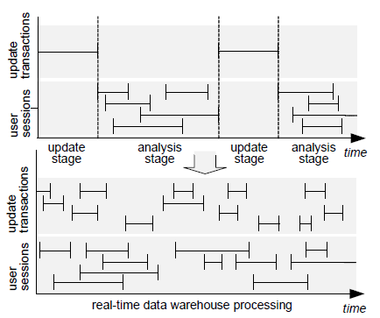
Motivation
Last day – perform ETL regularly (daily, weekly)
New trend – load data into DW when it is created
Real-time DW
Near real-time DW
Right-time DW
Image from M.Thiele, U.Fischer, and W.Lehner. Partition-based workload scheduling in living data warehouse environments (DOLAP '07)

Slide 4
Motivation (2): Real-time BI
Progression of BI
  Transactional reporting “give me my reports”
  Data warehousing/OLAP “explore data to find interesting patterns/details”
  Business Performance Management (BPM) “how am I tracking to business goals?”
  Guided Analytics/Business Activity Monitoring “where should I look next?”
  Tactical decisions “what do I do right now?”
Examples:
  Recommendations
  Fraud Detection
  Target Ads (cross-sell, up-sell)
  Business monitoring and operational performance management
Ideas from D.A.Schneider. Practical Considerations for Real-Time BI. Keynote of BIRTE’06

Slide 5
Motivation (3): Real-time BI
Requirement #1: Time is Money
  Need to reduce data latency – specialized HW or SW solutions
Requirement #2: Actionable Data
  Context, Audience, Clean data, Timeliness
Challenges:
  Data Scale
  User Scale
  Breadth of data access (context)
  Performance, Performance, Performance
  Cost
  High Availability and fault tolerance
  Integration
  Backup and recovery
Ideas from D.A.Schneider. Practical Considerations for Real-Time BI. Keynote of BIRTE’06

Slide 6
Right-time DW
Delivery may be real-time (seconds) but underlying data can be less “fresh”
Data must be in a DW when is needed, but not necessarily before that.
Common strategy: mini-batch ETL
RiTE:
  Bulk-load insert speed for data producer (ETL application)
  Fresh data for data consumers (OLAP)
  INSERT-like data availability, but with bulk-load speeds

Slide 7
RiTE middleware
Bulk loading is not efficient to use when the data sizes are small
For near real-time and right-time DW, regular SQL INSERT statements are used, leading to slow insert speed
  The RiTE solution finds the correct batch size between the two extremes (bulk load vs. single-row INSERT) and the right time to make data available in the DW
Assumptions:
  One data producer (ETL application)
  Many concurrent data consumers
  Lower persistency requirements (data can be reloaded from source systems in the case of crash during loading)

Slide 8
The RiTE Package
A specialized JDBC database driver for the producer
A specialized JDBC database driver for the consumers
A main-memory based catalyst
  Provides intermediate storage (“memory tables”) for (user-chosen) DW tables
  Offers fast insertions
  Offers concurrency control
  The data can be queried while held by memory tables
    This can be done transparently to the end user
  Eventually the data is moved to its final target – the physical DW tables
A PostgreSQL table function makes the data available in the DW

Slide 9
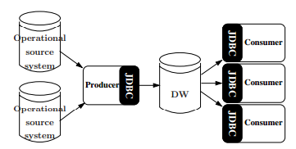
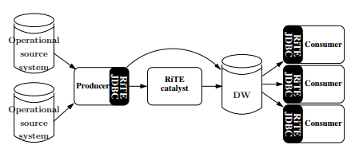
The RiTE Architecture
A classical
system
A system
using RiTE

Slide 10
RiTE User-oriented Operations
Producer operations:
  INSERT
  COMMIT (with materialization or without)
Consumer operations:
  SELECT (read)
  ENSURE ACCURACY (data freshness requirement in minutes)

Slide 11
Agenda
Motivation
The RiTE Package
RiTE Operations:
  Producer Side
  Catalyst
  Consumer Side
Performance
Conclusions
Some ideas borrowed from http://www.inf.unibz.it/dis/research/seminar_slides/pedersen08.pdf

Slide 12
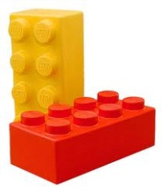


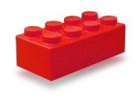
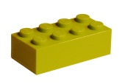
Running Example
Data Warehouse
Red_bricks
Size | Amount
Yellow_bricks
Size | Amount

Slide 13
Producer Side
Setup:
  Specialized RiTE JDBC driver
  Which tables are controlled by the catalyst?
Insert:
  (Red_bricks(1,1), (2,2), Yellow_bricks (3,3))
Flush:
  Commit by producer
  Producer executes a query that should consider (uncommited) data inserted by the producer itself
Red_bricks
Size | Amount
Red_bricks
Size | Amount
1 | 1
2 | 2
Red_bricks
Size | Amount
1 | 1
2 | 2
Yellow_bricks
Size | Amount
3 | 3
Red_bricks
Size | Amount
Red_bricks
Size | Amount
Yellow_bricks
Size | Amount
Producer
(The factory)
Catalyst
Consumer

Slide 14
Producer Side (2)
Lazy Commit:
Red_bricks
Size | Amount
Red_bricks
Size | Amount
1 | 1
2 | 2
Red_bricks
Size | Amount
Red_bricks
Size | Amount
Yellow_bricks
Size | Amount
3 | 3
Yellow_bricks
Size | Amount
Producer
(The factory)
Catalyst
Consumer
Red_bricks (arch; T=2)
Size | Amount
1 | 1
2 | 2

Slide 15
Producer Side (3)
Requests for data:
Producer inserts (1,1) into Red_bricks
Producer commits
Producer inserts (2,2) into Red_bricks
Producer commits
Red_bricks
Size | Amount
2 | 2
Red_bricks
Size | Amount
1 | 1
Red_bricks
Size | Amount
Red_bricks
Size | Amount
1 | 1
Red_bricks
Size | Amount
Red_bricks
Size | Amount
Yellow_bricks
Size | Amount
Red_bricks (arch; T=2)
Size | Amount
1 | 1
Catalyst
Consumer
Consumer asks catalyst to hold the data which is at most 2 timestamps old.
(5-2 = 3)
Producer flushes data in archive T=2
Red_bricks (arch; T=4)
Size | Amount
2 | 2
Producer
(The factory)

Slide 16
Producer Side (4)
Materialize:
Policies
  Decide when data in archives is flushed
  Flush immediately after a commit (default)
  Wait as long as possible (only flush on-demand)
  Flush when the load average is below some percentage or a certain time interval has passed since the last flush
Red_bricks
Size | Amount
Red_bricks
Size | Amount
1 | 1
2 | 2
Red_bricks
Size | Amount
Yellow_bricks
Size | Amount
3 | 3
Red_bricks
Size | Amount
1 | 1
2 | 2
Yellow_bricks
Size | Amount
Producer
(The factory)
Catalyst
Consumer

Slide 17
Producer Side (5)
The minmax Table:
  Producer tracks which rows are in the catalyst (available for consumer)
Red_bricks
Size | Amount
Red_bricks
Size | Amount
1 | 1
2 | 2
Red_bricks
Size | Amount
1 | 1
2 | 2
Yellow_bricks
Size | Amount
3 | 3
Red_bricks
Size | Amount
Yellow_bricks
Size | Amount
Producer
(The factory)
Catalyst
Consumer
min | max
3 | 2
rowID = 1 and rowID = 2
min | max
1 | 2
No available rows in the catalyst!

Slide 18

Catalyst Side
Fast intermediate storage for data in main memory.
Store rows for a producer
Deliver them to a table function (consumer)
Delete rows when they are marked as unused (no consumer currently uses them and they have been materialized)
The Row Index:
  For each memory table store row IDs

Slide 19


Catalyst Side (2)
The Time Index
  For each memory table store time index – for commit time t maps to row ID of the last row. Not committed rows time ∞.
  $$τ\left(t_{1}\right)=2$$
Producer inserts and commits two rows (1,1) and (2,2)
Producer inserts and commits two more rows
Red_bricks
Size | Amount
Red_bricks
Size | Amount
1 | 1
2 | 2
Red_bricks
Size | Amount
4 | 4
5 | 5
Red_bricks
Size | Amount
1 | 1
2 | 2
Red_bricks
Size | Amount
1 | 1
2 | 2
4 | 4
5 | 5
Yellow_bricks
Size | Amount
3 | 3
Red_bricks
Size | Amount
Red_bricks
Size | Amount
Yellow_bricks
Size | Amount
Producer
(The factory)
Catalyst
Consumer
  $τ\left(t_{2}\right)=$5

Slide 20


Catalyst Side (3)
Ensuring Accuracy
  Consumer requires the data with certain accuracy – not older than n’th timestamp.
  Timestamps are ordered! t₁ < t₂ < t₃ …. < t_{n} … < ∞
Producer lazy commits (no new rows were inserted!)
Catalyst requests for data committed at t₃
This is useful knowledge for catalyst.
Red_bricks
Size | Amount
Red_bricks
Size | Amount
1 | 1
2 | 2
Red_bricks
Size | Amount
1 | 1
2 | 2
4 | 4
5 | 5
Yellow_bricks
Size | Amount
3 | 3
Red_bricks
Size | Amount
Red_bricks
Size | Amount
Yellow_bricks
Size | Amount
Producer
(The factory)
Consumer
  $$τ\left(t_{3}\right)=\text{5}$$
Catalyst
Empty update
  $$τ\left(t_{1}\right)=\text{2} τ\left(t_{2}\right)=5$$

Slide 21
Catalyst Side (4)
Ensuring Accuracy (cont.)
  When consumer asks to ensureAccuracy (..), the catalyst returns a time handle telling the commit time for data that has at least the desired freshness.
  If consumer does not ask explicitly, the catalyst keeps all data committed before now.
  Timestamps for the tables guarantee consistent snapshots of committed data!

Slide 22
Catalyst Side (5)
Registering Rows as Being Used
  Rows are registered before (user) query starts and
  are deregistered when it finishes.
  It applies only to not materialized rows.
  Rows cannot be deleted while are registered as being used.
  Rows that are materialized and not registered as used can be deleted.
  The data consumers see committed rows exactly once (either in the catalyst or in DW)

Slide 23
Consumer Side
Registering Rows as Being Used
  Read vales from minmax table: from the first row that is not materialized when the query starts to the last row that is commited when the query starts.
  Register them in the catalyst.
  If failure (rows are already materialized in DW), start from step1.
Ensuring Accuracy of Read Data
  Relevant when producer uses lazy commits.
Reading Data with the Table Function
  DW reads the data through a table function (i.e., stored procedure)
  Old rows are already in DW
  New rows (from minRow to maxRow) are in the catalyst
  Consult minmax table about row IDs

Slide 24
Consumer Side (2)
Example
Producer inserts two more rows and commits them.
Consumer issues a very loooong query:
  Read minmax table → (min = 3, max = 5)
Producer inserts and commits more rows
  Minmax table is not updated until consumer query is finished
Red_bricks
Size | Amount
4 | 4
5 | 5
Red_bricks
Size | Amount
Red_bricks
Size | Amount
4 | 4
5 | 5
Red_bricks
Size | Amount
1 | 1
2 | 2
Yellow_bricks
Size | Amount
3 | 3
Red_bricks
Size | Amount
1 | 1
2 | 2
Red_bricks
Size | Amount
Yellow_bricks
Size | Amount
Producer
(The factory)
Catalyst
Consumer
min | max
3 | 2
min | max
3 | 5
min | max
1 | 2

Slide 25
Consumer Side (3)
Transparency
    CREATE VIEW v AS
    SELECT * FROM dwtable
    UNION ALL
    SELECT * FROM tablefunction('dwtable',
    (SELECT min FROM minmax),
    (SELECT max FROM minmax));

Slide 26
Agenda
Motivation
The RiTE Package
RiTE Operations:
  Producer Side
  Catalyst
  Consumer Side
Performance
Conclusions
Some ideas borrowed from http://www.inf.unibz.it/dis/research/seminar_slides/pedersen08.pdf

Slide 27
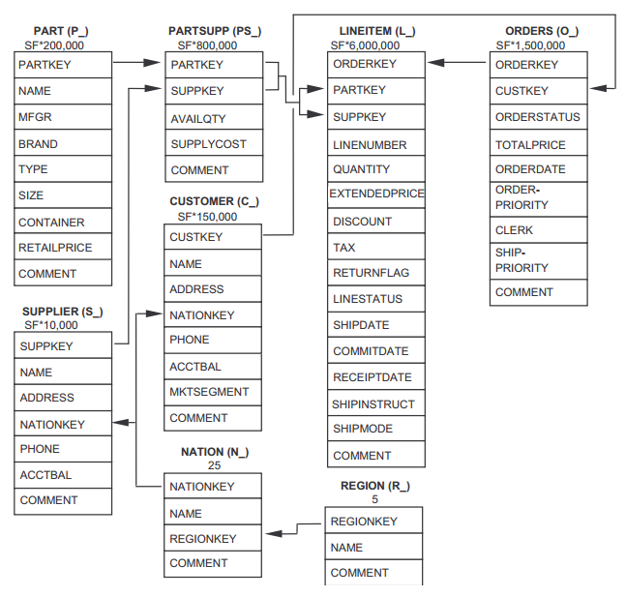
Performance
TPC-H benchmark data with a star schema
  Only fact table
  (LINEITEM) data
  is used.
  6 integer columns:
    Custkey,
    Datekey,
    Orderkey,
    Partkey,
    Suppkey,
    Quantity.

Slide 28
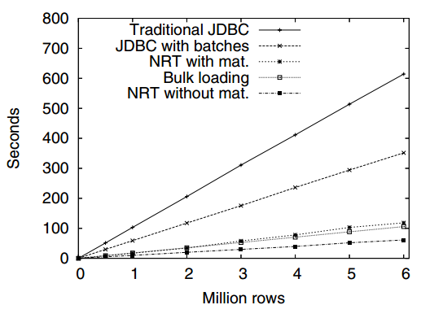
Performance (2)
Long transactions
  Commit after
  the last insert
  JDBC batch
  size 10,000 rows
RiTE is almost as fast as bulk loading
RiTE without materialization is 74% faster than bulk loading
RiTE
RiTE

Slide 29
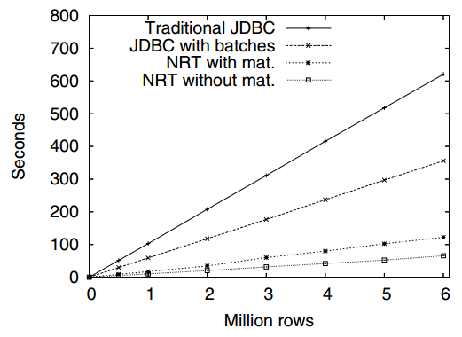
Performance (3)
Short transactions
  Commit for every
  10,000 rows
RiTE is fastest!
RiTE
RiTE

Slide 30
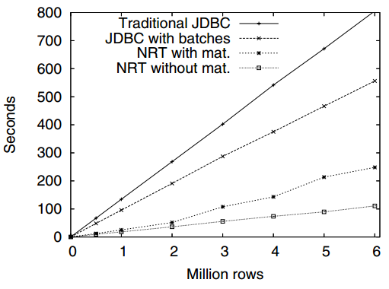
Performance (4)
Influence from a Consumer
  Short transactions
  (commit every 10,000
  rows)
  Consumer queries
  (constantly)
  SELECT SUM(quantity)
RiTE is fastest!
RiTE
RiTE

Slide 31
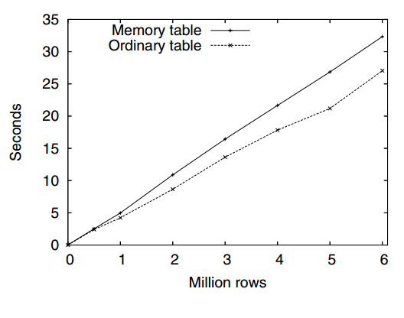
Performance (5)
Read Performance
Memory table is slower due to type conversions (from Java to native machine’s) and data transfer from the catalyst to DBMS.

Slide 32
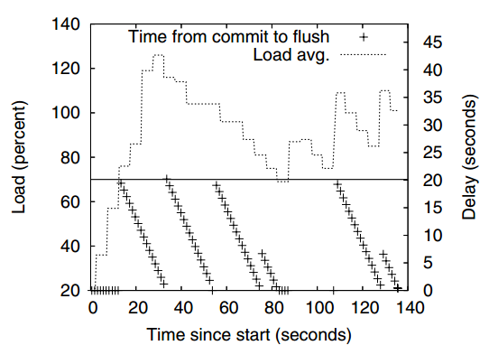
Performance (6)
Lazy Commit Delays
  System load below 70%
  20 sec. have passed
RiTE provides significant performance increase with very little overhead (for the read of memory tables)

Slide 33
Conclusions
RiTE makes inserted data available quickly
RiTE provides bulk-load speeds (up to 10 times faster than INSERT)
RiTE introduces innovative main-memory catalyst
RiTE works transparently for data producer and data consumer.

Slide 34
Future Work
Logging for the catalyst (guarantee persistency)
Transparent updating and deletion in memory tables
(beneficial for data cleansing)
Xiufeng Liu, Christian Thomsen, Torben Bach Pedersen. All-RiTE: Right-Time ETL for Live DW Data. [Not published, available http://xiufeng.site44.com ]
The catalyst could be implemented as a module in the DBMS to speed up type conversions
Indexes and constraints in the memory tables

