Slide 1
Effectively Indexing Uncertain Moving Objects for Predictive Queries
by Meihui Zhang, Su Chen, Christian S. Jensen, Beng Chin Ooi, Zhenjie Zhang
(National University of Singapore, Aalborg University)
Presenter: Dalia Kaulakiene (daliak@cs.aau.dk)

Slide 2
Effectively Indexing Uncertain Moving Objects for Predictive Queries
Extremely difficult paper
by Meihui Zhang, Su Chen, Christian S. Jensen, Beng Chin Ooi, Zhenjie Zhang
(National University of Singapore, Aalborg University)
Presenter: Dalia Kaulakiene (daliak@cs.aau.dk)

Slide 3
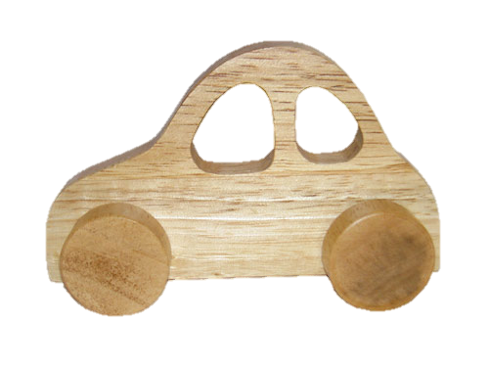
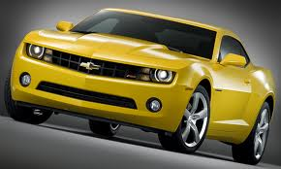
Main idea
Moving-object indexing + Probabilistic object modeling
+

Slide 4
Motivation
Asymmetric information gap between object’s real movement and the abstraction used to model its movement in the DB.
Current deterministic models are unable to capture info on the uncertainty of the moving objects.

Slide 5
Previous work
Uncertain trajectories of moving objects
  [21] – object trajectories are expanded by epsilon
  [6] – location uncertainties are updated at every time point
Uncertain prediction models
  [11] – possible locations of moving objects with varying probabilities
No work on uncertain location + uncertain velocity

Slide 6
Terms
B⁺-tree
B^{x}-tree
ST²B-tree
TPR-tree
TPR*-tree
Hilbert curve

Slide 7
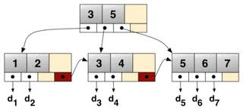
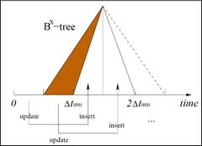
Terms – B⁺ and B^{x}-trees
B⁺-tree
B^{x}-tree =
Space filling curve +
B⁺-tree
(by csj, D.Lin, C. Ooi)
ST²B-tree = Self-Tunable Spatio-Temporal B+-Tree index
  density-based clustering into K partitions
(by S.Chen, C.Ooi, others)

Slide 8
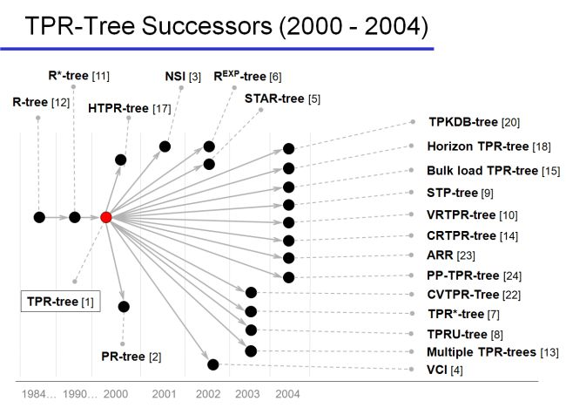
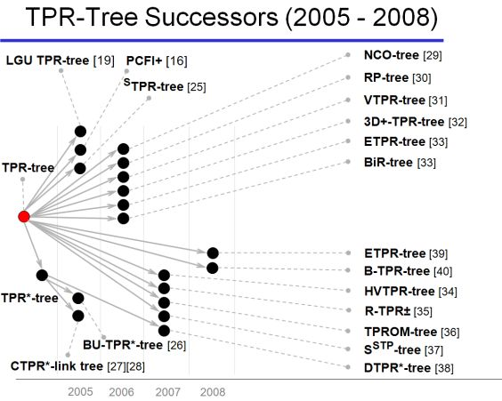
Terms TPR and TPR*-tree
TPR-tree (S. Šaltenis, C. S. Jensen, S. T. Leutenegger, M. A. Lopez:
Indexing the Positions of Continuously Moving Objects)
TPR*-tree (Y. Tao, D. Papadias, J. Sun: The TPR*-Tree: An Optimized Spatio-temporal Access Method for Predictive Queries)

Slide 9
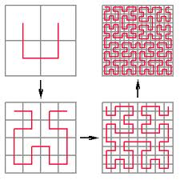
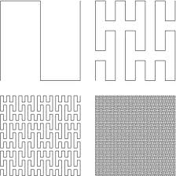

Terms – Space Filling Curve
Hilbert curve
Peano curve
Dragon curve

Slide 10
Contribution
Introduce many notations
Define:
  Probabilistic Range Query
  Top-k Probabilistic NN Query (k-PNN)
Method for inferring the location distribution of an uncertain moving object based on the most recently reported location and velocity distributions:
  Rectangle Inference
  Monte-Carlo Simulation
Index structure for Uncertain moving objects
Query processing
Experiments

Slide 11
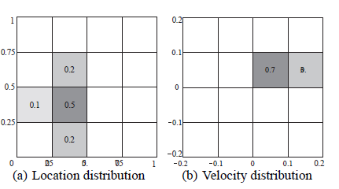
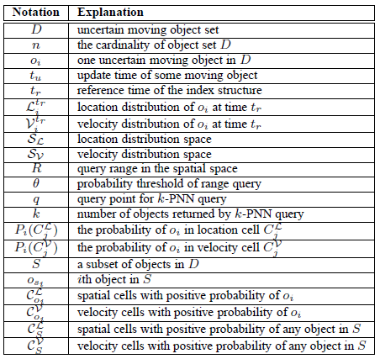
Notations
Exact location -> location distribution
Exact velocity -> velocity distribution
Probabilities and more ☺

Slide 12
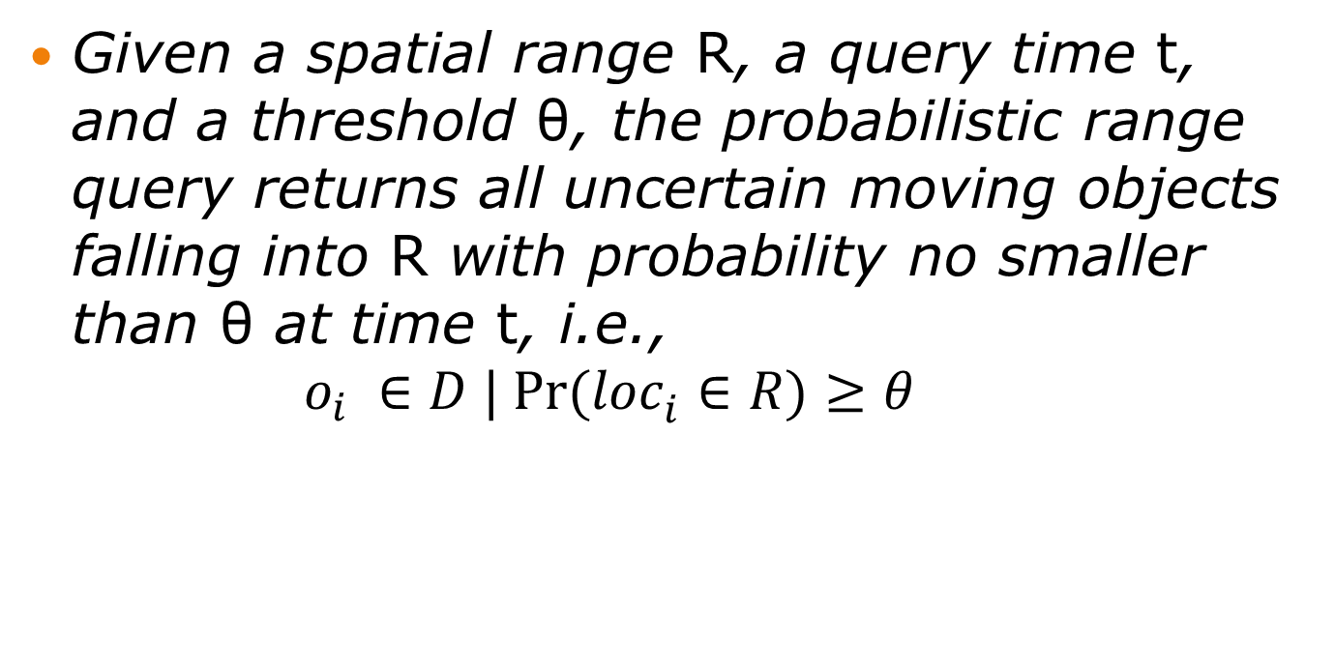
Probabilistic Range Query
Given a spatial range R, a query time t, and a threshold θ, the probabilistic range query returns all uncertain moving objects falling into R with probability no smaller than θ at time t, i.e.,
$o_{i} ∈D | Pr⁡({{loc}_{i}^{}∈R)≥θ}_{}$

Slide 13
Top-k Probabilistic NN Query
Given a query location q and a query time t, the probabilistic nearest neighbor query returns k uncertain moving objects with the highest probabilities of being the nearest neighbor of q.

Slide 14
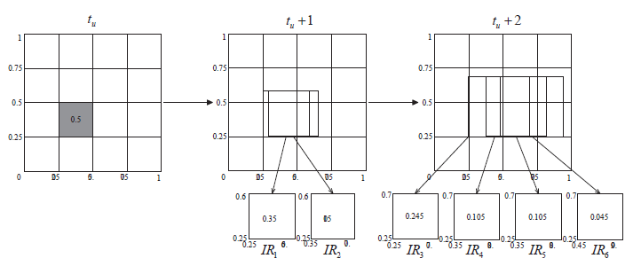
Rectangle Inference
Rectangle Inference

Slide 15
Monte Carlo Simulation
Algorithm 2 Monte Carlo Query Verification
1: Clear Success Counter SC = 0
2: Calculate N = 2 ln(1/δ)/epsilion2 θ
3: for sample a number l from 1 to N do
4: Randomly pick a location loc depending on the location distribution of o_{i} at update time t_{u}
5: for time point z from t_{u} + 1 to t do
6: Randomly pick a velocity vel depending on the velocity distribution of o_{i}
7: loc = loc + vel
8: if loc 2 R then
9: SC = SC + 1
10: if SC θN then
11: Return TRUE
12: Return FALSE

Slide 16
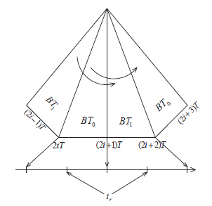
Index structure for Uncertain moving objects
B^{x}-tree for
Time domain
ST²B-tree for Velocity domain
  Partition into K parts to decrease query expansion during query processing
  Velocity Minimal Bounding Rectangles

Slide 17
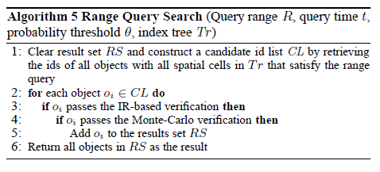
Query Processing – Range Query

Slide 18
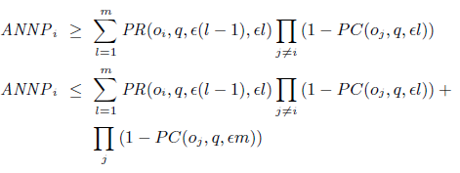
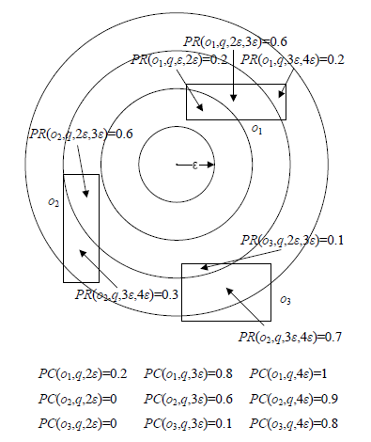
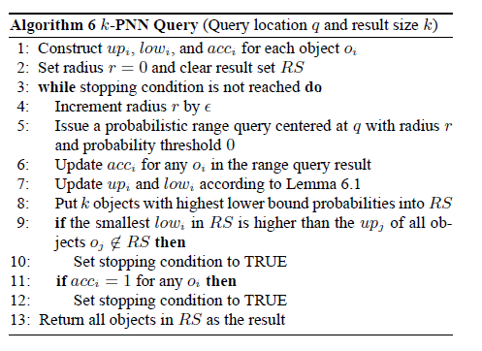
Query Processing – k-PNN

Slide 19

Query Processing – k-PNN
low
up
$$θ$$
If k objects found, then:

Slide 20
Experiments
Generated dataset
Experiments only with alterations of “our” algorithm
BUT: with lots of parameters!

Slide 21
Reflextions
Not well-written paper:
  Inconsistent notations
  Calculation error?
  Not precise algorithm
Citation count: 4
  1 by the same authors

Slide 22
Excersise!

Slide 23
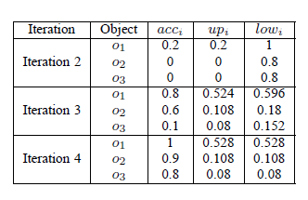
Excersise!

Slide 24
Back up slides

Slide 25
Contribution
Define some conditions (uncertain locations, trajectories…)
State that no work is done under these conditions
Apply 3 techniques that may solve the problem
Perform experiments
Get paper accepted in some conference

