Slide 1
A general Framework for Geo-Social Query Processing
Nikos Armenatzoglou, Stavros Papadopoulos and Dimitris Papadias
VLDB 2013
Kasun s Perera

Slide 2

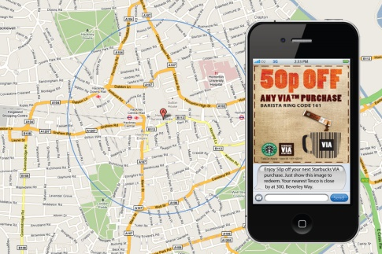
Geo-Social Query Processing
Geographical (Location Based) Information + Social Interaction Information
Personalized and localized advertisements
  4 in 1 menu for group of 4 people, to be sent to close by groups of 4 friends

Slide 3
Outline
Geo-social query processing framework
  Architecture
  Primitive queries
Query processing
  Basic queries
  Advanced queries
Experiments
  Setup
  Results
Summary

Slide 4

GeoSN Architecture
Social Module (SM)
  Own indexing and algorithms
Geographical Module (GM)
  Own indexing and algorithms
Query Processing Module (QM)
Social Module (SM)
Query Processing Module (QM)
GeoSN Queries
Results
Geographical Module (GM)

Slide 5
Primitive Queries
Social Module
  GetFriends(u)
    Returns friends of given user U
  AreFriends(u_{i},u_{j})
    Decides whether given two users are friends
Geographical Module
  GetUserLocation(u)
    Returns the location of a given user
  RangeUsers(q,r)
    Returns all the users within a range of radius r to a given location q
  NearestUsers(q,k)
    Given a location q and integer k, this returns nearest k users to the location q

Slide 6
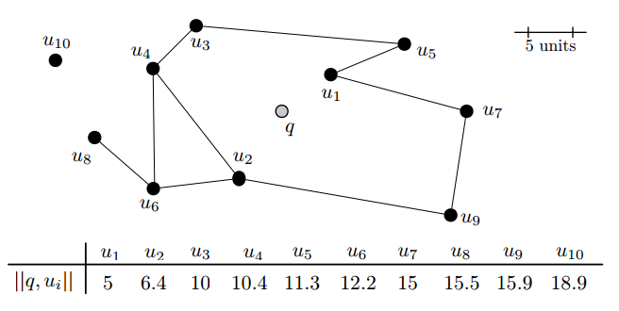
Query Processing
Running Example

Slide 7
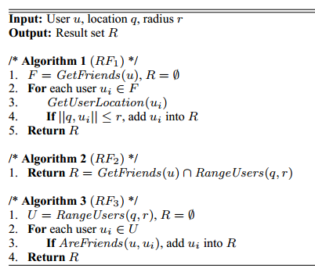

Range Friends
Given a user u, a 2D point q and a positive real number r, a RangeFriends(u,q,r) returns a set R defined as:
  $R=\left\{u_{i} | AreFriends\left(u,u_{i}\right)∧\left\|q,u_{i}\right\|≤r\right\}$

Slide 8
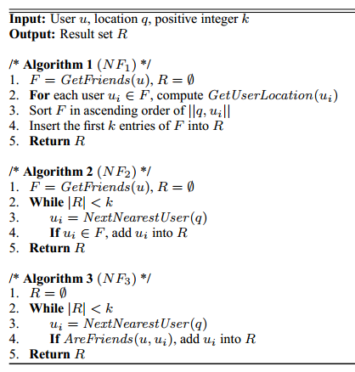

Nearest Friends
Given a user u, a 2D point q and a positive integer k, a NearestFriend(u,q,k) returns a list $R=\left(u_{1}..u_{k}\right)such that for each 1≤i≤k:$
$AreFriends(u,u_{1})∧\left\|q,u_{i}\right\|≤\left\|q, u_{i+1}\right\|∧(∄u^{′}:u^{′}∉R⋀AreFriends(u,u^{′})⋀\left\|q,u^{′}\right\|<\left\|q,u_{k}\right\|)$

Slide 9
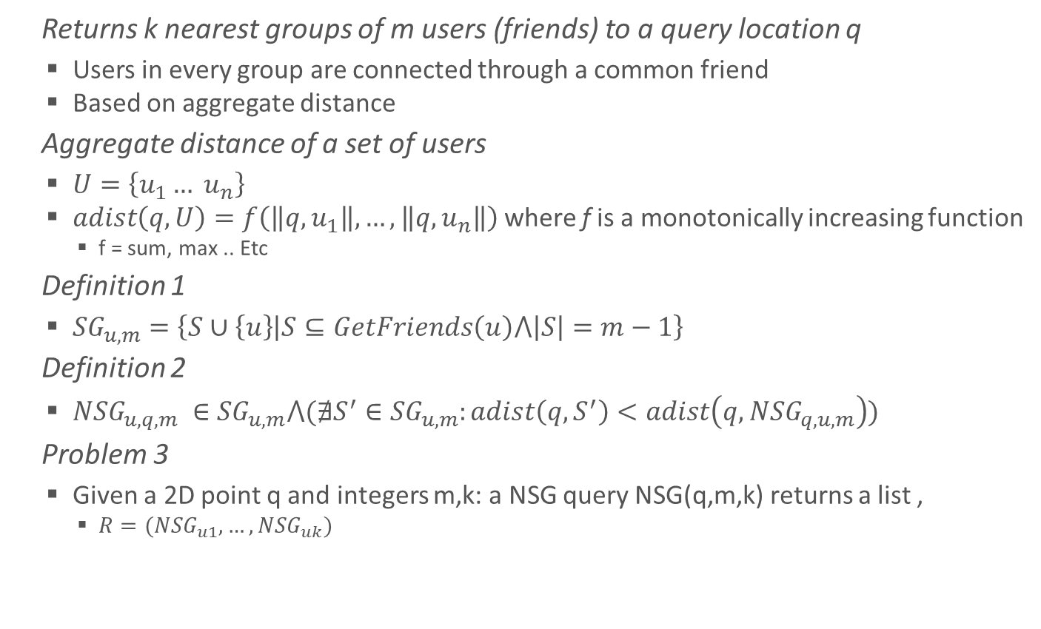
Nearest Star Group
Returns k nearest groups of m users (friends) to a query location q
  Users in every group are connected through a common friend
  Based on aggregate distance
Aggregate distance of a set of users
  $U=\left\{u_{1}… u_{n}\right\}$
  $adist\left(q,U\right)=f\left(\left\|q,u_{1}\right\|,…,\left\|q,u_{n}\right\|\right)$where f is a monotonically increasing function
    f = sum, max .. Etc
Definition 1
  ${SG}_{u,m}=\left\{S∪\left\{u\right\} | S⊆GetFriends\left(u\right)⋀\left|S\right|=m−1\right\}$
Definition 2
  ${NSG}_{u,q,m} ∈{SG}_{u,m}⋀(∄S^{′}∈{SG}_{u,m}:adist\left(q,S^{′}\right)<adist\left(q,{NSG}_{q,u,m}\right))$
Problem 3
  Given a 2D point q and integers m,k: a NSG query NSG(q,m,k) returns a list ,
    $R=({NSG}_{u1},…,{NSG}_{uk})$

Slide 10

Nearest Star Group Query
Each NSG in R is
  ${NSG}_{U_{i}}∈NSG ⋀adist(q,{NSG}_{U_{i}})≤adist(q,{NSG}_{U_{i+1}})⋀(∄{NSG}_{u^{′}}:{NSG}_{u^{′}}∈NSG∧{NSG}_{u^{′}}∉R∧adist\left(q,{NSG}_{u^{′}}\right)<adist(q,{NSG}_{u_{k}}))$
Running Example
  Restaurant at location q,

Slide 11
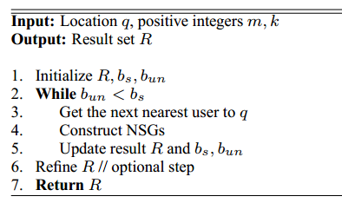
NSG Algorithm
Skeleton of NSG Algorithm
Lower Bounds
NSG of user q

Slide 12
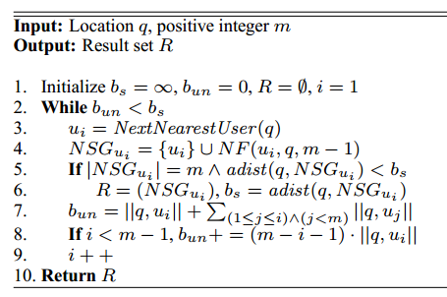

NSG Eager
Every new user $u_{i}$, eagerly construct ${NSG}_{u_{i}}$
  Returns only the Nearest Star Group (not a set k as in definition)

Slide 13
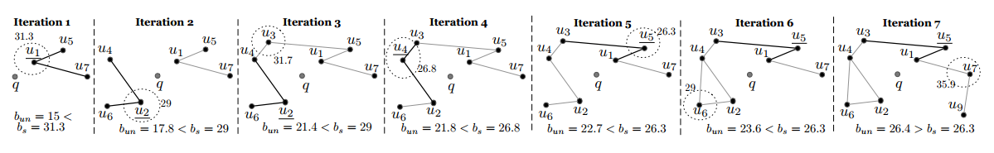
NSG_{eager}
NSG_{eager}

Slide 14
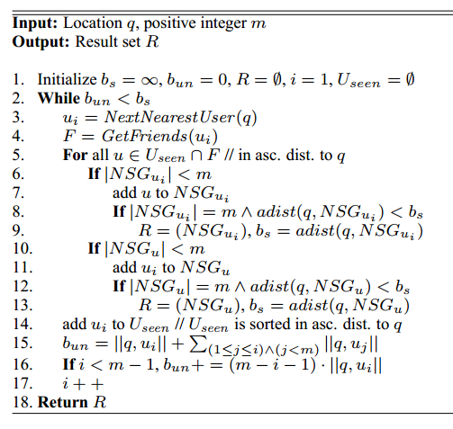
NSG Lazy
Similar to NSG_{eager}
  But lazily build NSG of seen users
  Elements in List U_{seen} is in ascending order of distance to q

Slide 15
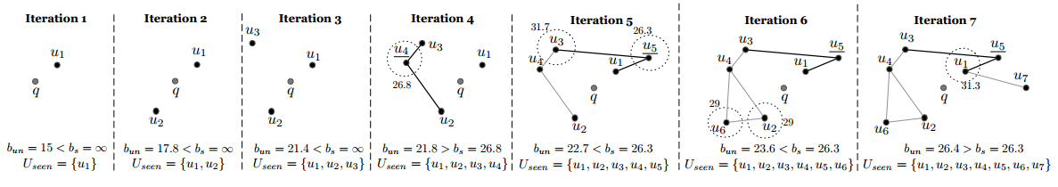
NSG_{lazy}
NSG_{lazy}

Slide 16
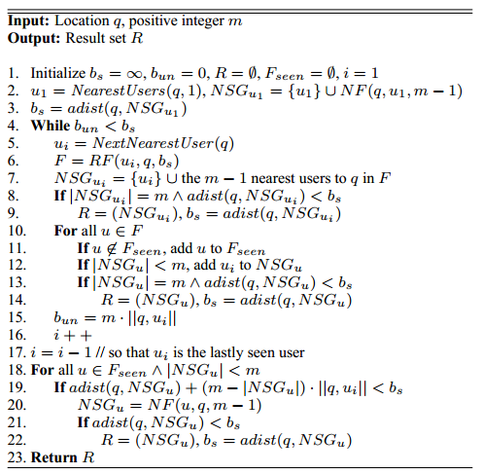
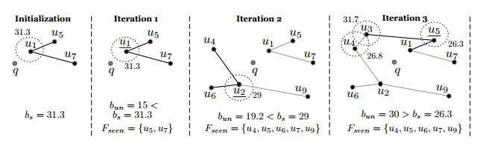
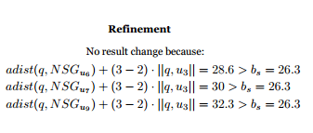
NSG*_{eager}
Optimization to NSG_{eager}
  Construct NSG_{ui} using only u_{i}’s friends in range b_{s}
  Increase b_{un} more aggressively to terminate faster

Slide 17
Experiments
Setup
  Storage approaches for SM and GM
    Disk-based (with cache)
    Memory based
  Disk-based Social Module / Geographical Module
    mongoDB
    One document for one user (UserID)
    U’s friends are in a sorted list (adjacency list) / coordinates
    Indexed using B⁺-Tree
  Memory-based SM/GM
    Hash table for SM
    300x300 Grid for GM with hash table for faster lookups
  Datasets
    Real, Foursquare and Twitter
    Synthetic, 5 sets with 1-5 Million users

Slide 18
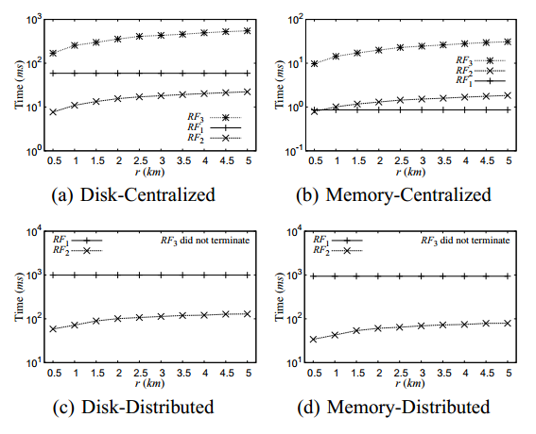
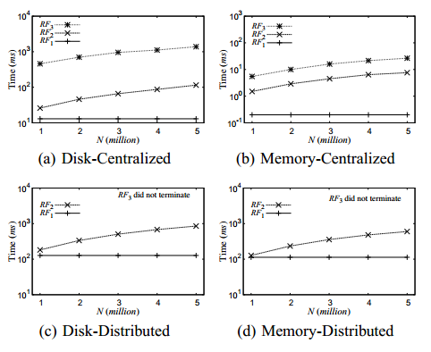
Experiments
Results
  Query Time for RF vs Range (r) Query Time for RF Vs N

Slide 19
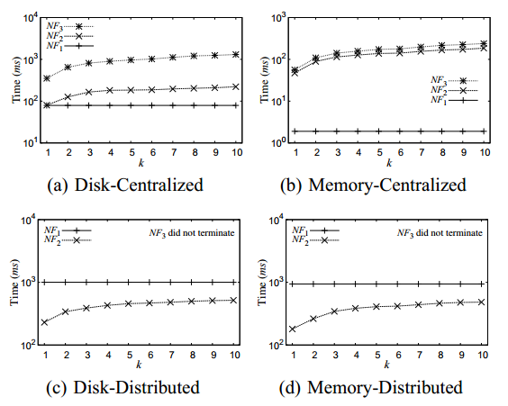
Experiments
Results
  Query Time for NF Vs k (number of friends)

Slide 20
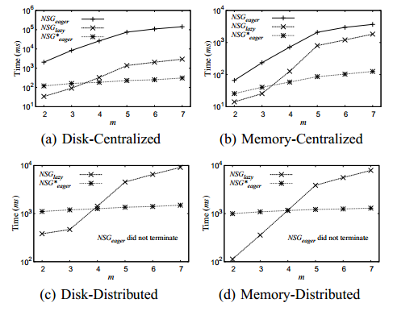
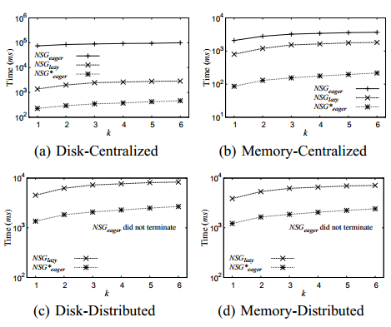
Results
Query time for NSG Vs m Query time for NSG vs k

Slide 21
Summary
Geo-Social Query Processing
Framework for GeoSN Query Processing
  Segregation of SM, GM and QM
  Query Primitives
  Basic Queries
  Advance Queries
Different algorithms for each query
  3 algorithms for Nearest Friends, Range Friends
  Nearest Star Group
    NSG_{eager}, NSG_{lazy}, NSG*_{eager}

Slide 22
A general Framework for Geo-Social Query Processing
Nikos Armenatzoglou, Stavros Papadopoulos and Dimitris Papadias
Kasun s Perera

