Slide 1
GraphMCS: Discover the Unknown in Large Data Graphs
Kasun S perera

Slide 2
Introduction
Property graph model
  Support complex expressive queries
Flexibility at a cost
  Result in an unexpected empty answer
  Trial and error to find out the reason for empty answer
Introducing Diff-Query
  Shows which part presents in Data Graph and which part is missing
  Maximum common subgraphs between a query graph and data graph and compute the difference

Slide 3
Outline
Motivation
Contribution by authors
Problem formulation
Finding common connected sub-graphs
Diff-graph and diff-query
Optimization
Evaluation
summary

Slide 4
Motivation
GraphDB user has limited knowledge about data
  Complicates creation of queries
  Over specifying may result an empty answer
    Confusion since reason not known
User needs guidance through the query answering process
  Possibility for explorative queries
Why not queries
  Why are the items with predicate P is not in the result
  Manual process of exploring data is cumbersome
Related work
  Operator manipulation over query and derive an answer to specific item
  Computing provenance of possible answers for SPJ queries
  Automatically generated query
    Response consist of original results and items of interest

Slide 5
Contribution
A query in GraphDB is a pattern that has to seek in a large data graph
To tell what is missing
  Find maximum common subgraphs in a data graph for a given query
  Calculate difference between them and the query graph
Diff-queries present discovered maximum common subgraphs of a datagraph and corresponding missing parts of the query graph.
All-covering spanning tree
  Processing of whole query graph
  Weakly connected graphs
  Produce larger subgraphs compared to standard techniqes

Slide 6
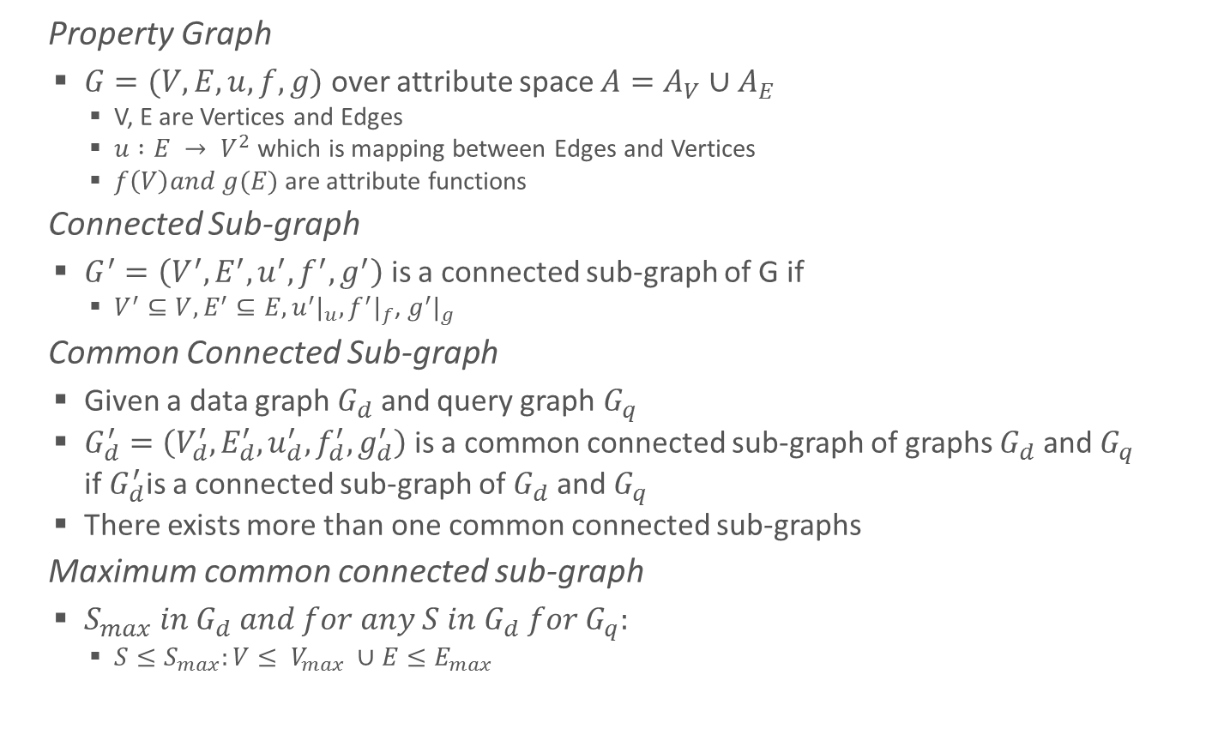
Problem Formulation
Property Graph
  $G=(V,E,u,f,g)$ over attribute space $A=A_{V}∪A_{E}$
    V, E are Vertices and Edges
    $u :E → V^{2}$ which is mapping between Edges and Vertices
    $f\left(V\right)and g(E)$ are attribute functions
Connected Sub-graph
  $G^{′}=\left(V^{′},E^{′},u^{′},f^{′},g^{′}\right)$ is a connected sub-graph of G if
    $V^{′}⊆V, E^{′}⊆E, u^{′}|_{u},f^{′}|_{f}$, $g^{′}|_{g}$
Common Connected Sub-graph
  Given a data graph $G_{d}$ and query graph $G_{q}$
  $G_{d}^{′}=\left(V_{d}^{′},E_{d}^{′},u_{d}^{′},f_{d}^{′},g_{d}^{′}\right)$ is a common connected sub-graph of graphs $G_{d}$ and $G_{q}$ if${ G}_{d}^{′}$is a connected sub-graph of $G_{d}$ and $G_{q}$
  There exists more than one common connected sub-graphs
Maximum common connected sub-graph
  $S_{max} in G_{d} and for any S in G_{d} for G_{q}:$
    $S≤S_{max}:V≤ V_{max} ∪E≤E_{max}$

Slide 7
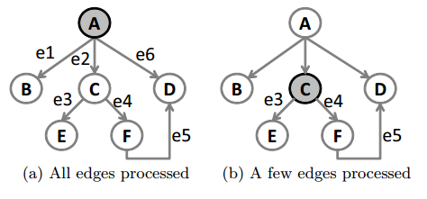
Finding Common Connected Subgraphs
Computation depends on how the graph is stored
  Adjacency matrix or adjacency list
  Ullmann’s brute-force tree search
  McGregor algorithm
    Backtracking algorithm
  Extension of McGregor algorithm to work with property graph model
Depth-first search
To ensure discovery of all MCC Sub-graphs
  Need to search on every vertex
  NP-Complete problem

Slide 8
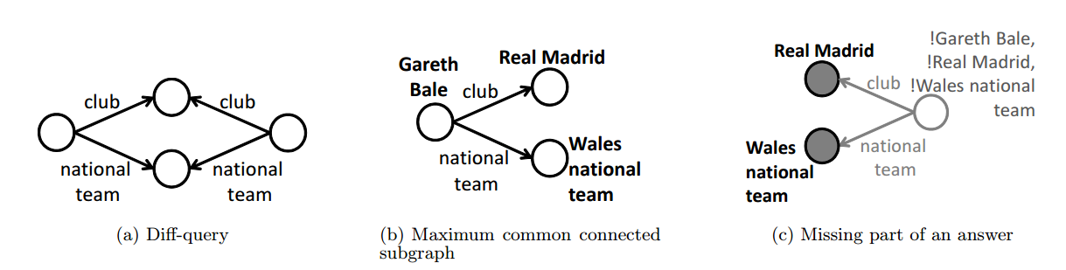

Diff-Graph and Diff-Query
Difference Graph
  The difference between discovered maximum connected sub-graphs and a query graph
  $G_{q}^{′}=\left(V_{q}^{′},E_{q}^{′},u_{q}^{′},f_{q}^{′},g_{q}^{′},V_{d}^{′}\left(adj\right),C\right)$where $V_{d}^{′}(adj)$ are adjacent vertices and C is set of non-adjacent discovered vertices to be excluded from further exploration
Diff-Query
  When a user get an empty response, conduct a diff-query
    In contrast to ‘why not?’
  Q – two players from same club and same national team

Slide 9
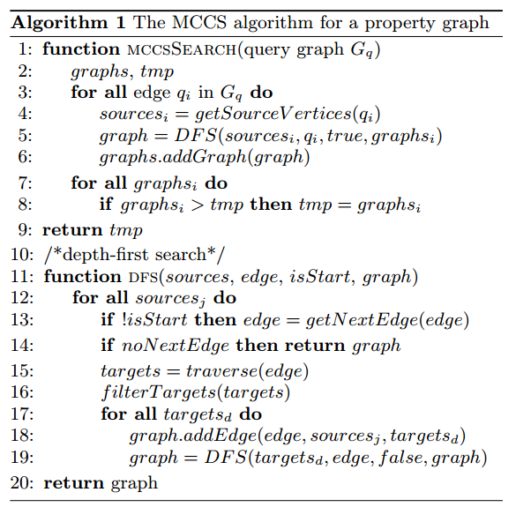
Detection of MCCS
Start vertices (projection vertices table
Multiple starts for all the vertices
Find the best possible sub-graph

Slide 10
Computation of Difference Graph
Use of query graph and discovered MCCS
  Step 1 - Split of discovered and un-discovered vertices and edges
  Step 2 - Completion of an undiscovered part with attributes or vertices conditions
  In step 1, Data edges, query edges, data vertices, query vertices in temporary tables
  Difference graph edges and vertices are not in these temporary tables
  Edges with single vertex need to complete by adding corresponding end vertex from discovered part
  In step 2 – which conditions have to be applied to graph discovered in step 1
    Adding discovered end vertex
    Removing discovered vertices with all edges discovered from such vertex

Slide 11
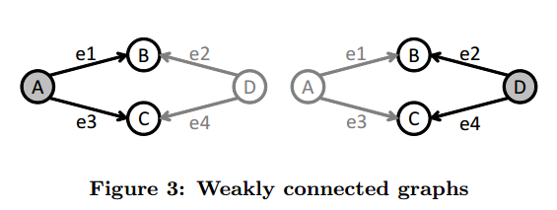
Multiple Starts, weakly connected graphs
General version of McGregor algorithm
  Run on all vertices as starting points
    No edge left behind
    Generate large intermediate results
    Increased response time
  Extension of the search for weakly connected graphs
  Restart to avoid missing some MCCS

Slide 12
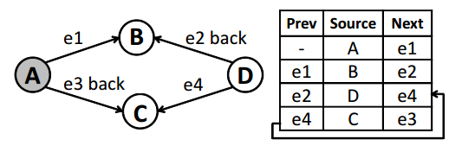
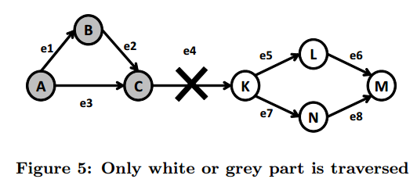
To reach unreachable components
all-covering spanning tree
  With backtracking procedure
  Process all the vertices and edges, not required multiple runs
Restart strategy
  Absence of some edges in the data graph may results smaller sub-graph

Slide 13
Restart Strategy
Maintain a list of traversed edges of a query graph
After first set of MCCS, remove all edges presented in the set from the list
Restart from the left-over part
MCCS
MCCS
Maximum Common Subgraph

Slide 14
Choice of Start and Restart Edges
General McGregor algorithm
  Process graph from all query vertices and produce the biggest graph as MCCS
  Which query vertex should be taken as a start?
    Intermediate results depend on cardinality of processed vertices and edges
    General query graph results a large amount of intermediate results
Start strategy to select start vertex, start edge and next branch to traverse
  Vertex with the maximum degree as start point
    Potentially reduce the number of restarts
  Cardinality for all vertices and edges in query graph
    Sorts them separately
    Select the edge with lowest cardinality as start edge
    All-covering spanning tree – selects a search direction based on cardinality of the source and target
Termination
  No more edges found and backtracking returns to start
  Threshold based termination
    Estimated size of MCS
    Number of discovered MCSs
    Use cardinality of a query to calculate these values

Slide 15
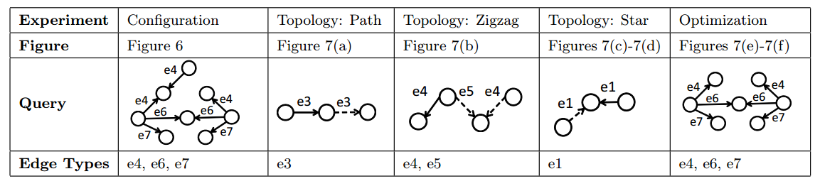
Evaluation
Property graph from data from DBpedia RDF triples
  20K vertices, 100K edges
Without all-covering spanning tree
  Only for connected components
All-covering spanning tree
  Weakly connected components
Restart strategy
  Unconnected components

Slide 16
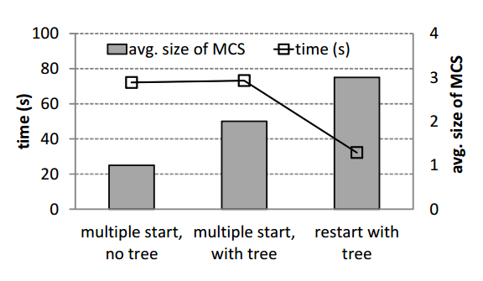
Evaluation
Three strategies

Slide 17
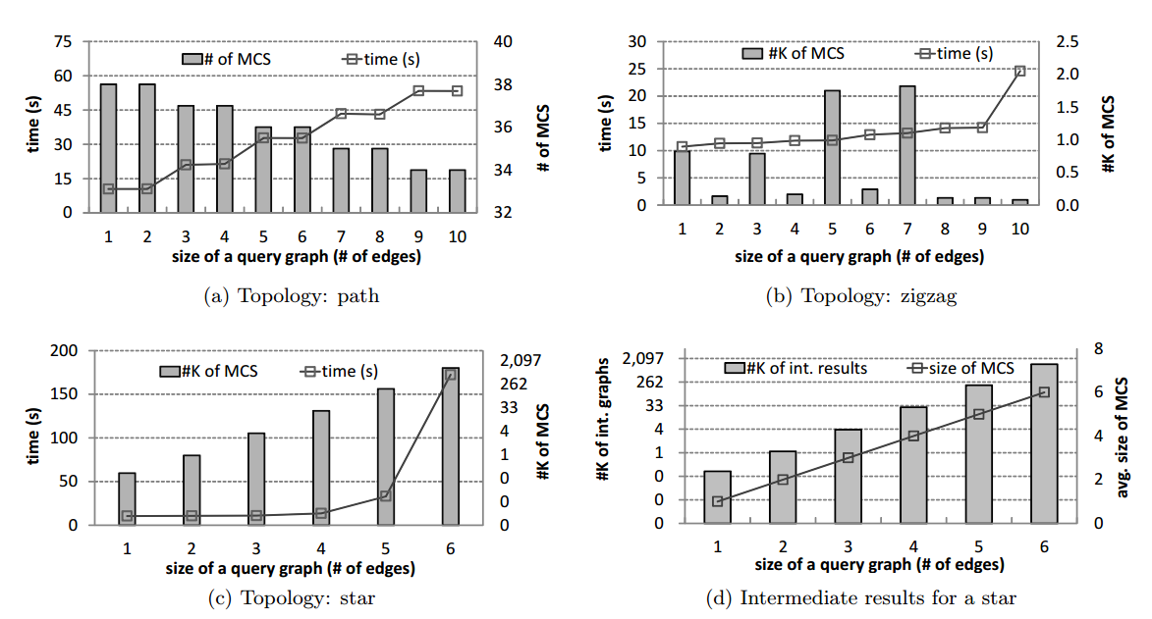
Evaluation
Topology

Slide 18
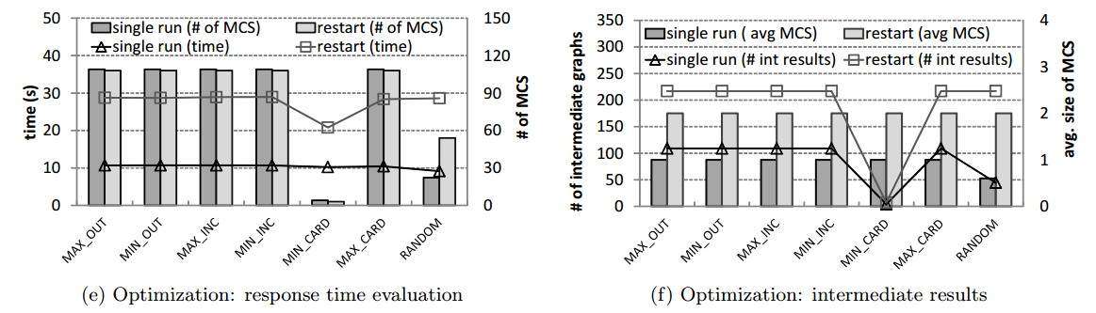
Evaluation
Optimization

Slide 19
Summary
Query on graph database may yield to an empty answer
Need to know the reason, or what are the missing parts
Diff-query
  Maximum common sub-graph between query graph and data graph
Computing difference graph and diff-query
  Multiple start, no all-covering spanning tree - connected
  Multiple start, all-covering spanning tree – weakly connected
  Restart with all-covering spanning tree – unconnected
Optimization strategies
  Start vertex, edge and next branch
  Threshold based termination

Slide 20
GraphMCS: Discover the Unknown in Large Data Graphs
Elena Vasilyeva, Maik Thiele, Christof Bornhövd, Wolfgang Lehner
Kasun S perera

