Slide 1
CrowdDB: Answering Queries with Crowdsourcing
Michael J. Franklin
Donald Kossman
Tim Kraska
Sukriti Ramesh
Reynold Xin
Presenter: Ilkcan Keles

Slide 2
Outline
Motivation
Crowdsourcing
  Mechanical Turk Basics
  Mechanical Turk APIs
  CrowdDB Design Considerations
Overview of CrowdDB
CrowdSQL
  Incomplete Data
  Subjective Comparisons
User Interface Generation
Query Processing
Experiments and Results
Conclusion

Slide 3
Motivation
RDBMSs make several key assumptions
  Correctness
  Completeness
  Unambiguity
Two fundamental problems
  Closed World Assumption
  Relational databases are extremely literal.

Slide 4
Motivation
SELECT market_capitalization FROM company
WHERE name = “I.B.M”;
Reasons
  Removal of I.B.M records because of a mistake
  Incorrect data entry
  Entity resolution problem
SELECT image FROM picture
WHERE topic = “Business Success”
ORDER BY relevance LIMIT 1;
Unless the relevance of pictures to specific topics is obtained and stored beforehand, the result can not be obtained from RDBMSs.

Slide 5
Motivation
These kind of queries could easily be answered by people.
In this work, they extend traditional query engine with a small number of operators to get human input.
Two main capabilities of human computation:
  Finding new data
  Comparing data.

Slide 6
Crowdsourcing
A crowdsourcing platform consists of:
  Requesters: Offer tasks
  Workers: Accept and work on the tasks
In this work, Amazon Mechanical Turk (AMT) is used.
  It provides API for requesting and managing the work.
AMT supports microtasks.
  Microtasks do not require any special training and typically take no longer than 1 minute to complete.
  While defining a task, requester should define price/reward.

Slide 7
Mechanical Turk Basics
HIT: A Human Intelligent Task
  Smallest entity of work
  Can contain one or more jobs.
Assignment
  Every HIT can be replicated into multiple assignments.
  Any worker processes at most a single assignment for each HIT.
  If the number of assignments is set to odd numbers, majority voting can be used to assure quality.
HIT Group
  AMT automatically groups similar HITs into HIT groups.
    The requester
    The title of the HIT
    The description
    The reward
  Workers typically choose the work based on HIT Groups.

Slide 8
Mechanical Turk Basics/Interfaces
Main AMT Interface
Worker
HIT Interface

Slide 9
Mechanical Turk API
createHIT(title, description, question, keywords, reward, duration, max Assignments, lifetime) → HitID
getAssignmentsForHIT(HitID) → list(asnId, workerId, answer)
approveAssignment(asnID)
  Approves an assignment
  Triggers the payment to the worker
  Triggers the payment of commission to Amazon
rejectAssignment(asnID)
  Rejects an assignment
  No payment to worker and no commission
forceExpireHIT(HitID)
  Expires a HIT immediately
  Workers assigned to this HIT may complete their work.

Slide 10
CrowdDB Design Considerations
Performance and Variability
  Speed and quality issues
  Malicious behavior and spamming
Task Design and Ambiguity
  Due to natural language and subjective requirements
  Design of user interface
  Quality control mechanisms
Affinity and Learning
  Relationship between requesters and workers
Relatively Small Worker Pool
Open vs. Closed World
  One query operator could return an unlimited number of answers
  Query planning, query execution costs and answer quality

Slide 11
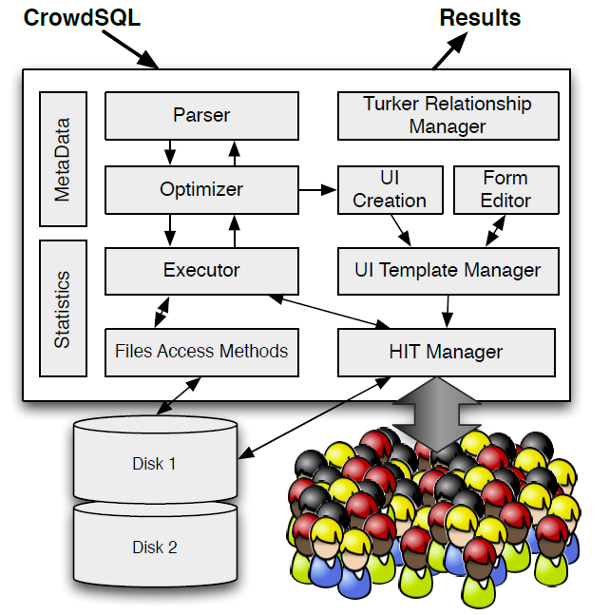
Overview of CrowdDB

Slide 12
New Components
Turker Relationship Manager
  Takes care of important requester duties
    Approving/Rejecting assignments
    Paying/Granting bonuses
  Helps requesters to build communities
User Interface Management
  Generates user interfaces related to HITs
HIT Manager
  Manages the interaction between CrowdDB and AMT
  Makes API calls to post HITs, assess their status and obtain the results
  HITs to be posted are determined by query compiler and optimizer

Slide 13
CrowdSQL
A minimal SQL extension that supports crowdsourcing
It allows application developers to write SQL code in the same way as they do for traditional databases.
In most cases, developers are not aware that their code includes crowdsourcing.
Includes extensions related to missing data and subjective comparisons.

Slide 14
Incomplete Data/SQL DDL Extension
Two types of crowdsourcing:
  Specific attributes of tuples could be crowdsourced.
  Entire tuples could be crowdsourced.
Allows any column and table to be marked with CROWD keyword.
CrowdDB does not impose any limitations with respect to SQL types and integrity constraints.
  Referential integrity constraints can be defined between
    Two CROWD tables
    Two regular tables
    One regular table and one CROWD table

Slide 15
Incomplete Data/SQL DDL extension
CREATE TABLE Department (
university STRING,
name STRING,
url CROWD STRING,
phone STRING,
PRIMARY KEY (university, name) );
CREATE CROWD TABLE Professor (
name STRING PRIMARY KEY,
email STRING UNIQUE,
university STRING,
department STRING,
FOREIGN KEY (university, department)
REF Department(university, name) );

Slide 16
Incomplete Data/SQL DML Semantics
CNULL is introduced to show the values which have not been obtained yet
  Equivalent of NULL in standard SQL
  CNULL values are generated as a side effect of INSERT queries
  CNULL is the default value for each CROWD column
It is also possible to set the values of CROWD columns in INSERT statements. In this case, crowdsourcing will not be used to get the value.
INSERT INTO DEPARTMENT(university, name)
VALUES(“UC Berkeley”, “EECS”);
INSERT INTO DEPARTMENT(university, name, url)
VALUES(“ETH Zurich”, “CS”, “inf.ethz.ch”);

Slide 17
Incomplete Data/Query Semantics
CrowdDB supports all types of SQL queries on CROWD columns and tables.
When needed, CrowdDB uses crowdsourcing platform to fill incomplete data or to get new tuples.
SELECT url FROM Department
WHERE name = “Math”;
SELECT * FROM Professor
WHERE email LIKE “%berkeley%” AND
dept = “Math”

Slide 18
Subjective Comparisons
CROWDEQUAL
  Takes two parameters
  Asks the crowd to decide whether the two values are equal
SELECT profile FROM department
WHERE name ~= “CS”;
CROWDORDER
  Is used whenever the help of the crowd is needed to rank or order the results.
  Takes two parameters (column name and ranking question)
SELECT p FROM picture
WHERE subject = “Golden Gate Bridge”
ORDER BY CROWDORDER(p,
“Which picture visualizes better %subject”);

Slide 19
User Interface Generation
User interfaces are needed for crowdsourcing the information.
At compile-time CrowdDB creates templates for CROWD columns and tables.
At runtime, these templates are initiated to retrieve information from the workers of crowdsourcing platform.

Slide 20
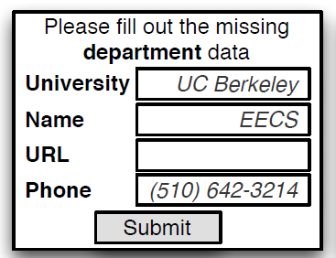
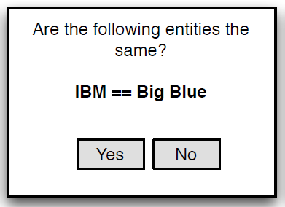
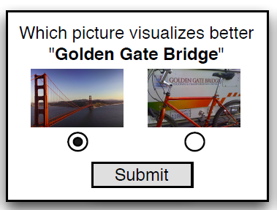
User Interface Generation/Examples

Slide 21
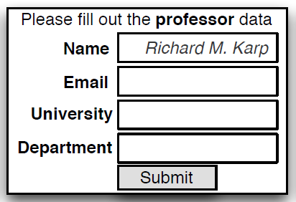
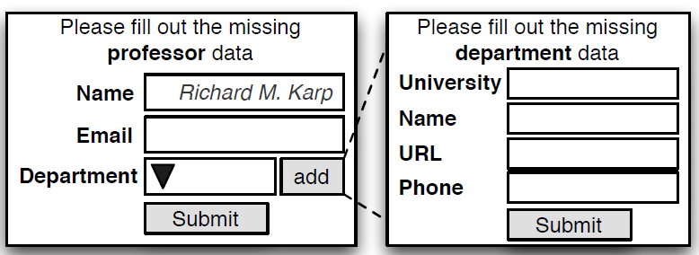
User Interface Generation/Examples

Slide 22
Query Processing
Query plan generation and execution follows a largely traditional approach
The main differences:
  CrowdDB parser is extended to parse CrowdSQL
  CrowdDB has additional operators for crowdsourcing
  CrowdDB optimizer uses special heuristics to generate plans with respect to the crowd operators

Slide 23
Crowd Operators
CrowdDB implements all operators of the relational algebra.
CrowdDB implements a set of Crowd operators.
  Basic functionality is the same for all crowd operators.
  Initialized with a user interface template and the standard HIT parameters for crowdsourcing.
Quality control is maintained by a majority vote.
The number of workers assigned to each HIT is controlled by Assignments parameter (static parameter of CrowdDB)

Slide 24
Crowd Operators
CrowdProbe
  Crowdsources missing information of CROWD columns and new tuples.
  Enforces quality control by selecting the majority answer for every attribute.
CrowdJoin
  Index nested-loop join over two tables
    At least one of them is crowdsourced
  For each tuple of outer relation, one or more HITs are created to crowdsource new tuples for inner relation.
  The quality control technique is the same with CrowdProbe.
CrowdCompare
  Implements CROWDEQUAL and CROWDORDER functions

Slide 25
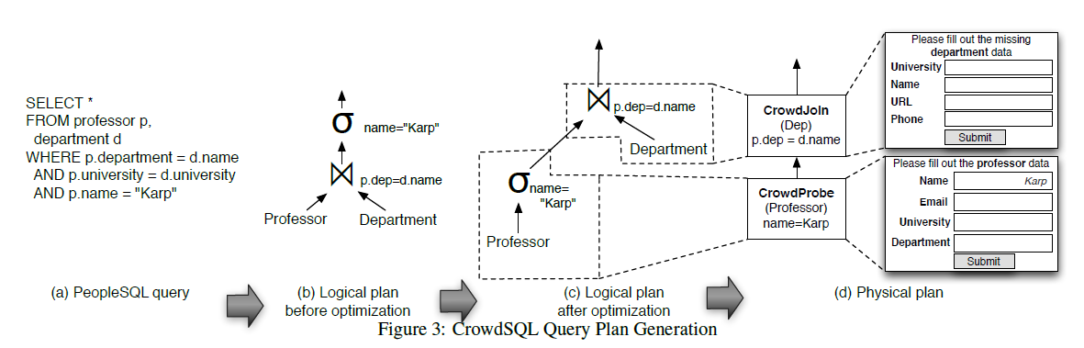
Physical Plan Generation
A query is first parsed and logical plan is created
Logical plan is optimized using traditional and crowd specific optimizations
Finally, the logical plan is translated into a physical plan

Slide 26
Heuristics
Based on a simple rule-based optimizer.
Implements several essential query rewriting rules such as predicate push-down.
Annotates the query plan with the cardinality predictions between the operators.
Re-orders the operators to minimize the requests.
In contrast to a cost-based optimizer, a rule-based optimizer is not able to exhaustively explore all parameters.

Slide 27
Experimental Results
They ran over 25,000 HITs on AMT during October 2010.
  Varying parameters such as price, jobs per HIT and time of day
  Response time and quality of answers are measured
Note that the results are highly dependent on
  The properties of the ATM platform at a particular point in time
  The specific tasks sent to the crowd

Slide 28
Micro Benchmarks
They start with simple tasks requiring workers to find and fill in missing data for a table with two crowdsourced columns:
The table is populated by 3607 businesses in 40 USA cities.
Groups of 100 HITs are posted and each HIT involves 5 assignments.
By default, the reward for a HIT is 1 cent.
CREATE TABLE businesses (
name VARCHAR PRIMARY KEY,
phone_number CROWD VARCHAR(32),
address CROWD VARCHAR(256)
);

Slide 29
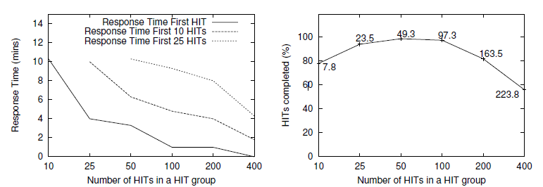
Experiment1
In this experiment, they examine the response time of assignments with respect to the number of HITs in a HIT group.

Slide 30
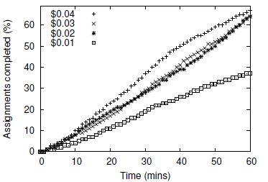
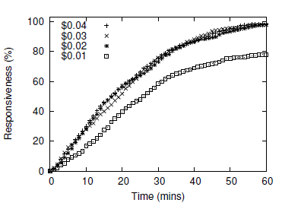
Experiment2
They examine how the response time varies with respect to the reward given to the workers.

Slide 31
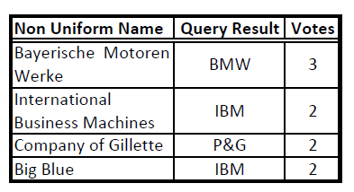
Complex Queries/Entity Resolution
A simple company schema with attributes company name and headquarter address is used.
It is filled with Fortune 100 companies.
Each HIT involves comparing ten company names with the non uniform name given and has 3 assignments.
SELECT name FROM company WHERE
name ~= “[a non-uniform name of the company]”

Slide 32
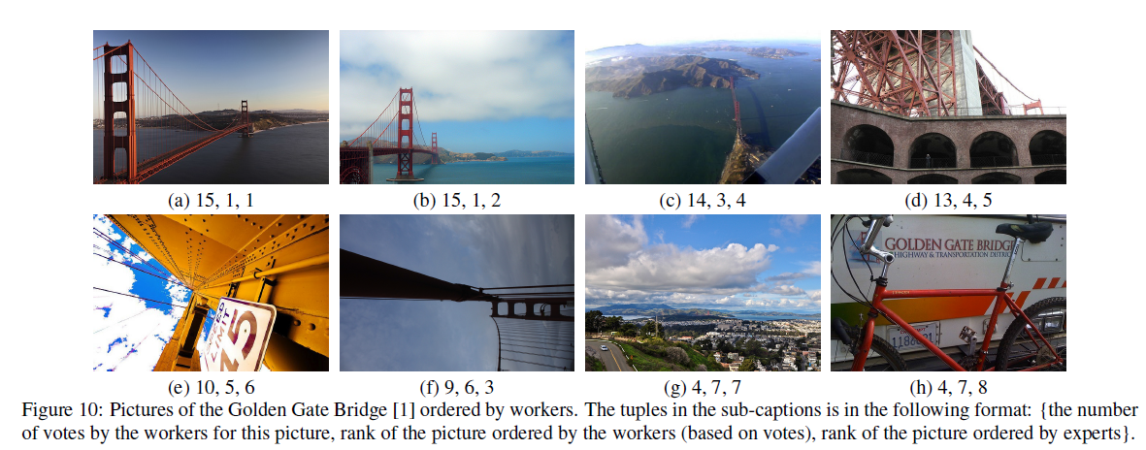
Complex Queries/Ordering Pictures
In this experiment, they asked for a ranking of pictures in different subject areas.
They tested 30 subject areas having eight pictures for each subject area.
Rankings are conducted with 210 HITs each with 3 assignments.

Slide 33
Conclusion
They highlight two cases where human input is needed:
  unknown or incomplete data
  subjective comparisons.
They introduce a new database system named CrowdDB. They apply simple extensions to SQL DDL and DML for crowdsourcing.
Performance, in terms of latency and cost, is also effected by the way in which CrowdDB interacts with workers.

Slide 34
Thank you

