Slide 1
Model-based Database Systems
Kasun Perera
April 2014

Slide 2
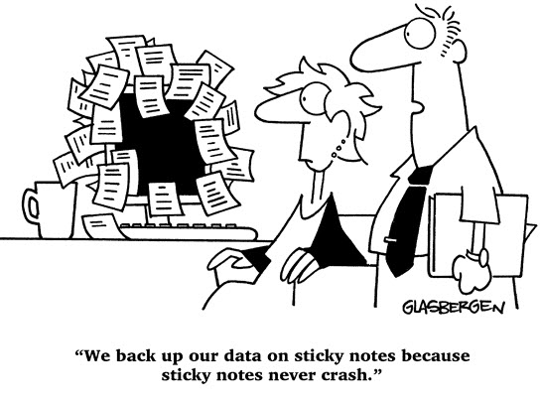
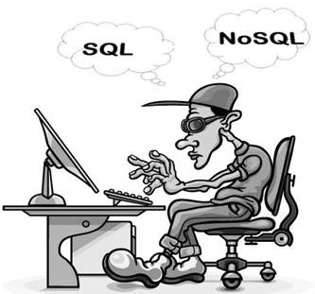
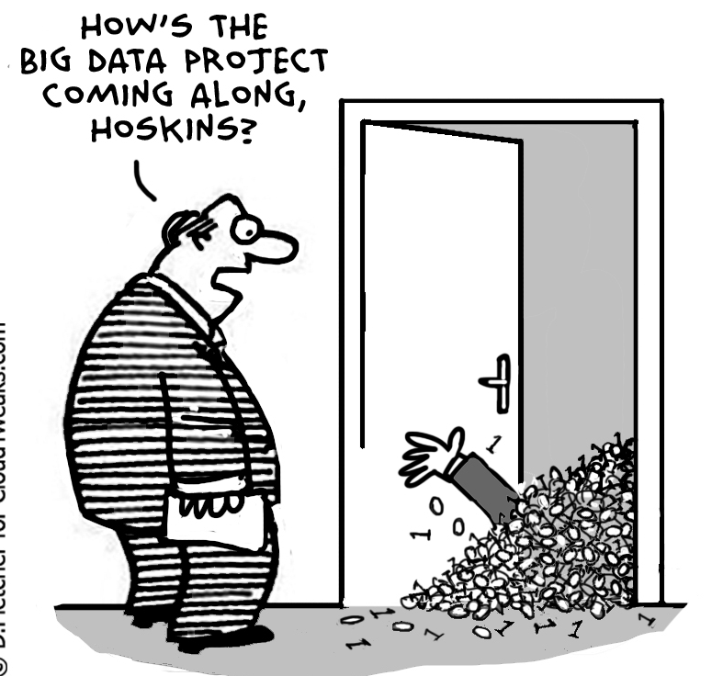

Introduction
Data storage
Data Access
Data amount
Focus Perspective

Slide 3

Motivation
Limitations Into the future
Big Data
Faster Access
Mining Intelligence
Models Vs Data Model and relational mix
User/Information centric Day-to-day transactions
Faster reliable access hierarchical access
support for mining intelligence

Slide 4
Objectives
A system
  Still usable with day-to-day transactions
  Able to handle big data
  Scalable
  Provide faster information mining
  Also provide forecasting functions
Benefits
  Faster access, faster results, accurate results
  Complete view over the data
  Scalability
Approach
  A model-based database architecture
Model: A simplified description, a mathematical one,
of a system or a process, to assist in calculations and predictions: (Oxford Dic)

Slide 5

Conceptual View of the System
User Query Action Selector
Model
Hierarchy Access
Traditional
Query Processor
Model
Query Processor
Model Maintenance
Data
Model Access
DB
Model Designer
Data Storage
Model Storage

Slide 6
Components
Model Query Processor and Model Access/Storage
Action Selector
Model
Query Processor
Model
Hierarchy Access
Parser
Traditional Query Processor
Optimizer
Data
Model Access
Executor

Slide 7
Components
Model Designer and Model Maintenance
  Offline Vs Online
  Adaptable
  Accounts for user feedbacks
  Dynamic updates
Model Maintenance
DB
Model Designer
Data Storage
Model Storage

Slide 8
Model Storage/Access
Hierarchical model storage and access
  Time dimension
  Other dimensions
    Geographic levels, branches, customers etc
Year
Month
Day
Day
Month
Day
Hour
Hour
Hour
Hour
Hour

Slide 9
Current Experiments
Modeling Time Series Data
Exponential Smoothing
  Holt-Winters model
    Works with good seasonality
Value
Time
Training Time
Forecast Window

Slide 10
Current Experiments
Time Series : hourly time series for energy price, energy demand
Compression Factor: 8
Error rate: 3% ~ 9.5%
Value
Seasonality
Trend
Base
Time
1 Week

Slide 11
Current Experiments
Peaks and Valleys
Compression Rate: 4
Error Rate: 4% ~ 6%
Value
Time

Slide 12
Mixed Approach
Exponential Smoothing with Peaks and Valleys
  Holt-Winters for periods with nice seasonality
  Peaks and valleys for distorted behaviors
  Compression Factor: ~ 4 -7
  Error Rate: ~ 4% - 8%
    Depends on the smoothing

Slide 13
Results
Time Series | Original Length | PeaksNValleys
 |  | RMSE | MAPE | MAE | Points | Compression Factor
ECG 308 | 5399 | 0.04097746 | Inf | 0.01586705 | 1656 | 3.2602657
Exchange Rates | 303 | 0.670403 | 0.468462 | 0.3207581 | 103 | 2.941747573
ECGx108 | 5399 | 0.01476273 | 0.12236 | 0.005747938 | 2586 | 2.087780356
Furnan | 575 | 365.1518 | 20.21246 | 241.4656 | 190 | 3.026315789
IBM Stock Data | 368 | 2.851322 | 0.281903 | 1.301527 | 206 | 1.786407767
UK Internet Traffic | 19887 | 71.62796 | 0.678505 | 25.53179 | 9540 | 2.084591195
Site1Wind | 157967 | 0.5826681 | 3.417917 | 0.2824687 | 37856 | 4.17283918
Site1Power | 157967 | 6.974421 | 5.768397 | 2.899868 | 60419 | 2.614525232

Slide 14
Results
Data Set | Experiment | Error Rate | Compression
UK Power Demand | For Weekday | 3.81 | 8
 | For Weekend | 7.33 | 8
 | Full Data Set | 5.744 | 8
NYISO Price Data | No Smoothing + Interpolation | 4.5454 | 4
 | Smoothing + Linear Regression (RMSE < 1.5) | 3.4249 | 3
 | Smoothing + Linear Regression (RMSE < 2) | 3.65 | 3

Slide 15
Related Works
Model to represent data
  mauveDB: [SIGMOD 2006]
    Model based views (complete view by hiding missing and erroneous data)
  A Model based approach to Updating databases with Incomplete Information [ACM Trans on DB Systems 1988]
  Querying Continues Functions in a Database System [SIGMOD 2008]
  SynopSys: Large Graph Analytics in the SAP HANA Database Through Summarization. [GRADES 2013]
Time Travel
  Model-based Integration of Past & Future [VLDB 2012]
  Time Travel in a Scientific Array Database [ICDE 2013]
  Time Travel in Column Stores [ICDE 2013]

Slide 16
Related Works
Models for single time series and multiple time series
  Forecasting the data cube [ICDE 2013]
  F2DB [ICDE 2012]
  Simultaneous Equation Systems for Query Processing on Continuous-Time Data Streams [ICDE 2008]
Handling large data, how to index
  iSax: Indexing and Mining Terabyte Sized Time Series [SIGKDD 2008]

Slide 17
Model-based Database Systems
Kasun Perera
April 2014

