Slide 1
Scalable Top-k Spatio-Temporal Term Querying
Anders Skovsgaard
Darius Sidlauskas
Christian S. Jensen
Presenter: Ilkcan Keles

Slide 2
Outline
Introduction
Problem Definition
Related Work
  Aggregation
  Frequent Item Counting
  Related Systems
Proposed Solution
  Adaptive Frequent Item Aggregator (AFIA)
  Stream Processing
  Query Processing
  Dynamic Summaries
Experimental Evaluation
Conclusion

Slide 3
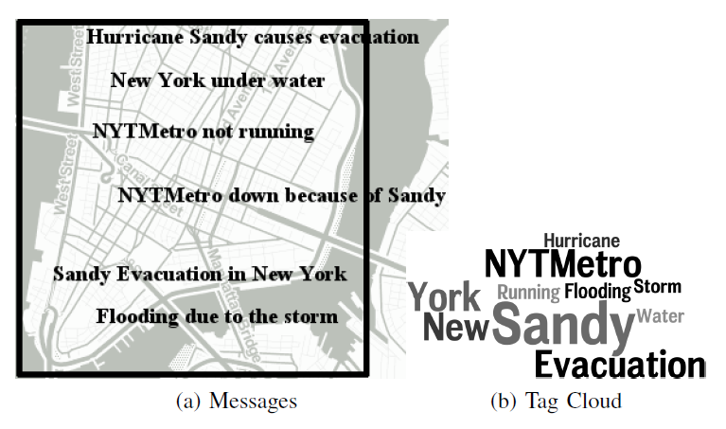
Introduction
Motivation
  What’s the “talk of the town” during a specific time interval?
Scalability
  To propose a solution that has the capability of supporting the entire world, a long history of content, and a stream with high rates.

Slide 4
Problem Definition
D – a set of spatio-temporal objects o.
o = (λ, doc, ts)
  λ – a point location (latitude and longitude),
  doc – a text document (composed of terms t),
  ts – a timestamp.
Score(t, D) = |{o ϵ D | t ϵ o.doc }| – score of a term t for a set D of objects.
Input: q = (k, R, I) – a top-k most popular terms query
  k – number of top terms
  R – a rectangular range
  I – a time interval
Output
  k top scored terms from objects {o ϵ D | o. λ ϵ R ∩ o.ts ϵ I}
  k_{g} – an integer ( ≤ k ) guaranteeing that the first k_{g} terms to have the highest scores (the rest of the terms are approximate)

Slide 5
Example
D consists 6 objects with the following documents:
  Hurricane Sandy causes evacuation of NYTMetro.
  NYC under water.
  NYTMetro not running.
  NYTMetro down because of Sandy.
  Sandy Evacuation in New York.
  Flooding due to the storm.
An exact query with k = 3 on this set will produce the result ({sandy, nytmetro, evacuation}, 3)

Slide 6
Related Work/Aggregation
Aggregation Types
  Distributive (sum, count, max)
  Algebraic (avg)
  Holistic (top-k)
Papadias et al. proposed the aggregation R-tree.
  Aggregation value of children of one node is stored as an attribute.
Yang and Widom proposed the SB-tree.
  Stores a hierarchy of intervals and their partially computed aggregates.
Since top-k is a holistic aggregate, these pre-computation techniques do not work.

Slide 7
Related Work/Frequent Item Counting
Two types of algorithms
  Counter-based (SpaceSaving, LossyCounting, and Frequent)
    Fixed number of counters
    If an unmonitored item occurs in the stream, the action is dependent on the algorithm. (ignore, replace with a current one)
  Sketch-based (CountSketch, GroupTest, Count-min Sketch)
    Approximate frequency for all items by using hash-based structure.
    Items are mapped to counters via a hash function.
    No guarantees about the relative ordering.
SpaceSaving algorithm is used [Metwally et al. 05].
  Finds the top-k elements
  Guaranteed relative ordering.
  If an unmonitored item arrives, it replaces a current item and is inserted with an error value.

Slide 8
SpaceSaving Algorithm
A B B A C A B B D D
 | A
C | 1
E | 0
 | B | A
C | 2 | 1
E | 0 | 0
 | B | A
C | 2 | 2
E | 0 | 0
 | B | A | C
C | 2 | 2 | 1
E | 0 | 0 | 0
 | B | A | C
C | 4 | 3 | 1
E | 0 | 0 | 0
 | B | A | D
C | 4 | 3 | 2
E | 0 | 0 | 1
 | B | A | D
C | 4 | 2 | 3
E | 0 | 0 | 1

Slide 9
Related Work/Systems
BlogScope
  Text documents from forums, blogs, news feeds, etc.
  Discovery and tracking of real-world stories.
  Does not contain aggregation about keywords.
NewsStand/TwitterStand
  Spatio-textual news aggregator.
  Users can query about specific keywords and regions.
  PostgreSQL for the backend processing.
  Do not work for high stream rates.

Slide 10
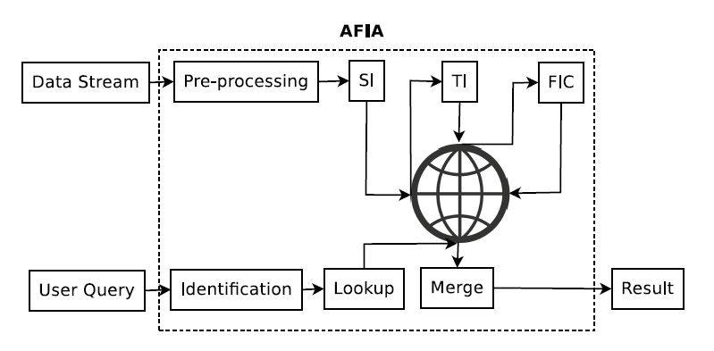
Adaptive Frequent Item Aggregator
Grid-based indexing with respect to the spatial and temporal information of pre-computed summaries
  Static uniform grids with predefined and fixed cell sizes.
  Multiple granularity levels for both spatial and temporal information.
Frequent item counting by extending the SpaceSaving algorithm.

Slide 11
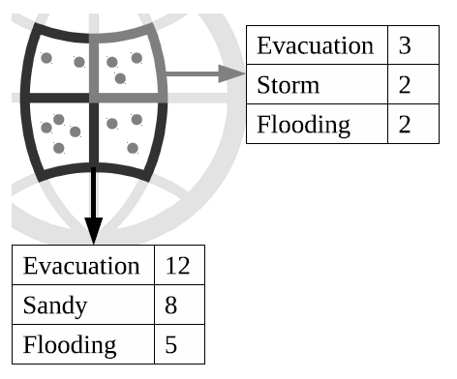
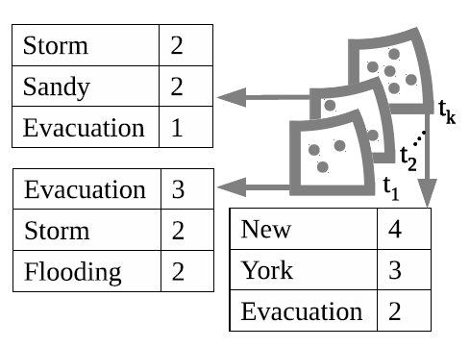
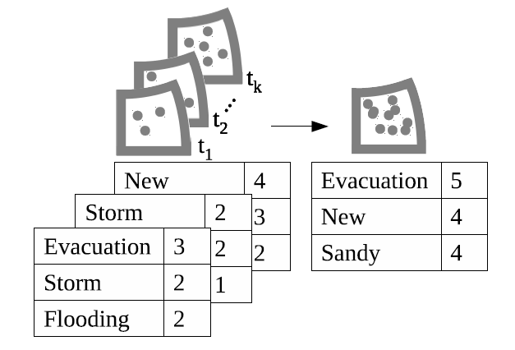
AFIA/Index Structure

Slide 12
AFIA/Stream Processing
Preprocessing of the input message
  Removal of stop words
  Splitting the message into terms
Retrieval of corresponding summaries
  Summaries related to all granularity levels are obtained.
Frequent Item Counting
  Summaries are updated by using the extended version of SpaceSaving algorithm.

Slide 13
AFIA/Query Processing
Corresponding grid indexes with respect to the query region and time interval are found
Lookup is performed to retrieve all corresponding summaries
A merge operation is applied to summaries obtained in the previous steps.
A result in the form of [R, k_{g}] is produced.
  R is a ranked list of top-k terms.
  k_{g} is the number of guaranteed top-k terms.

Slide 14
AFIA/Dynamic Summaries
Motivation
  If static summaries are used with few counters, it may not be possible to get the correct top-k terms.
  One possible solution is to set the number of counters to an extremely large number.
    Not feasible due to the excessive storage.
evacuation, evacuation, sandy, evacuation, sandy, storm
 | Evacuation | Storm
C | 3 | 3
E | 0 | 2

Slide 15
AFIA/Aggressive Increment
The main idea is to increase the number of counters when needed.
Counts of terms are inserted into the summary until all counters are used.
If all counters are used and an unmonitored item arrives
    If new term influences the top-k terms and the summary is error-free, then the number of counters is doubled.
    If the summary contains errors, to prevent the summary to fall into an inconsistent state, a checkpoint is signaled.
    Otherwise, it continues like the SpaceSaving algorithm and replaces the least frequent item.

Slide 16
AFIA/Aggressive Increment
If a monitored item goes into the top-k section of the summary after incrementing its count:
  The algorithm applies a rollback.
  A checkpoint is signaled.
To set the initial number of counters, a new parameter named initCounters is introduced.

Slide 17
AFIA/Checkpointing
Is introduced to prevent inconsistent summaries and top-k results with a possible error.
It is performed before an action (new insertion or incrementing the count) makes a summary inconsistent.
  The active summary becomes inactive and is archived.
  The number of counters is doubled.
  A new empty summary is created.
Due to checkpointing, every grid can contain multiple archived summaries.

Slide 18
AFIA/Example
evacuation, evacuation, sandy, evacuation, sandy, storm, hurricane, flooding, water, NYTMetro
Evacuation | 1, Δ = 0
Evacuation | 2, Δ = 0
Evacuation | 2, Δ = 0
Sandy | 1, Δ = 0
Evacuation | 3, Δ = 0
Sandy | 2, Δ = 0
Evacuation | 3, Δ = 0
Sandy | 2, Δ = 0
Storm | 1, Δ = 0
Aggressive Increment
Evacuation | 3, Δ = 0
Sandy | 2, Δ = 0
Storm | 1, Δ = 0
Hurricane | 1, Δ = 0
Evacuation | 3, Δ = 0
Sandy | 2, Δ = 0
Flooding | 2, Δ = 1
Hurricane | 1, Δ = 0
Evacuation | 3, Δ = 0
Sandy | 2, Δ = 0
Flooding | 2, Δ = 1
Water | 2, Δ = 1

Slide 19
AFIA / Example
evacuation, evacuation, sandy, evacuation, sandy, storm, hurricane, flooding, water, NYTMetro
Evacuation | 3, Δ = 0
Sandy | 2, Δ = 0
Flooding | 2, Δ = 1
Water | 2, Δ = 1
Evacuation | 3, Δ = 0
Sandy | 2, Δ = 0
Flooding | 2, Δ = 1
Water | 2, Δ = 1
Checkpoint
NYTMetro | 1, Δ = 0

Slide 20
AFIA/Compaction
Compaction of inactive summaries
  Two reasons for being inactive
    Checkpoint
    Time interval is finished
  Since we only need top-k terms from inactive summaries, the rest of the counters can be deleted.
  This way, we can release unneeded memory.

Slide 21
AFIA/Relaxed Decrement
The activity in a grid can change across time.
When the activity of a grid decreases, the number of counters should be decreased in order to increase memory utilization.
Since decreasing the number of counters can cause checkpoints frequently, it needs to be done carefully.
  Decrement the number of counters to the half if
    The grid does not have any checkpoints in the previous time granularity.
    If the summary has error-free elements at least doubling the targeted-k.

Slide 22
AFIA/Merging Dynamic Summaries
By using aggressive increment and checkpointing, it is guaranteed that the top-k terms in the summaries are error-free.
To give guarantees after a merge, targeted-k + 1 counters are maintained for each summary.
  The extra counter gives the count of the most frequent items outside of the top-k items.
  The best case for items outside of the top-k items is the sum of the values of these counters.

Slide 23
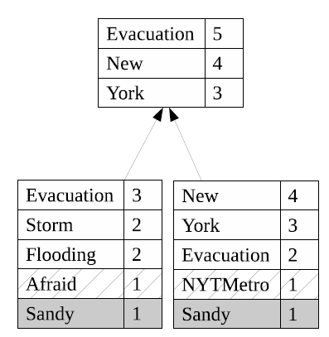
AFIA/Merge Example 1
For a top-3 query about this grid, the algorithm will return the result of ({Evacuation, New, York}, 3).

Slide 24
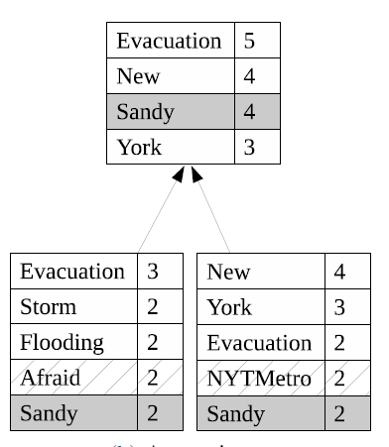
AFIA/Merge Example 2
For a top-3 query about this grid, the algorithm will return the result of ({Evacuation, New, York}, 2).

Slide 25
Experimental Evaluation
Data
  All geo-tagged posts from Twitter’s Streaming API during May, 2013.
  The total number of tweets is 110,426,053 (41 tweets/second).
Baselines
  SS: (approximate) frequent item aggregation using SpaceSaving.
  HT: (exact) frequent item counting using a hash table.

Slide 26
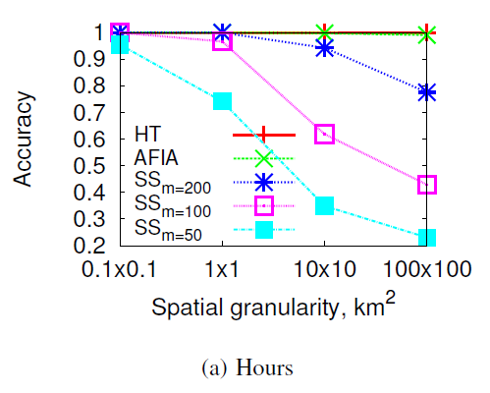
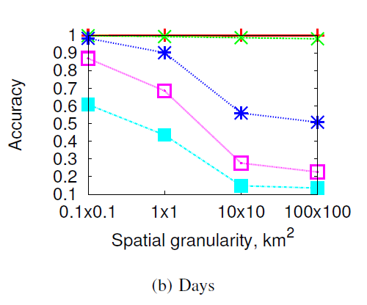
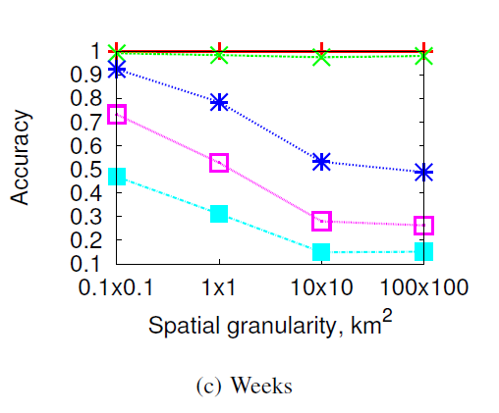
AFIA versus SS & HT

Slide 27
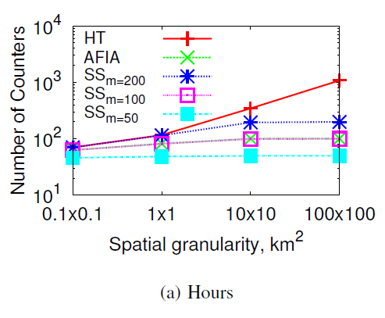
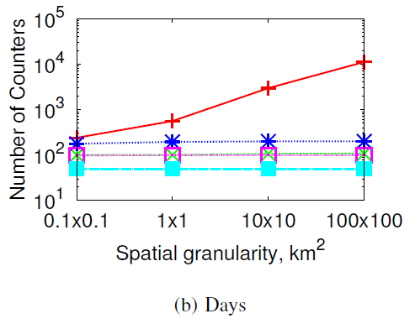
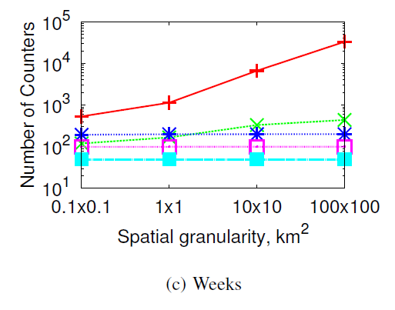
AFIA versus SS & HT

Slide 28
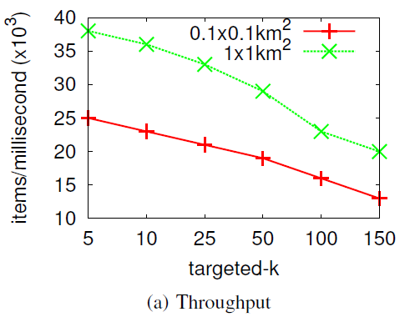
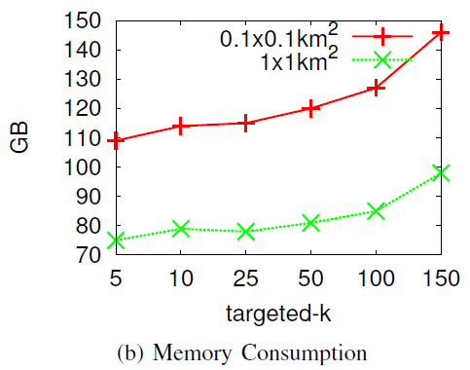
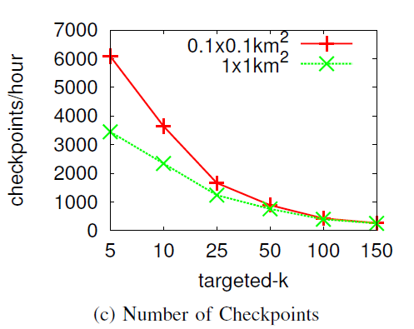
Varying targeted-k

Slide 29
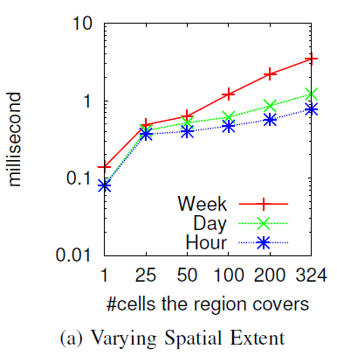
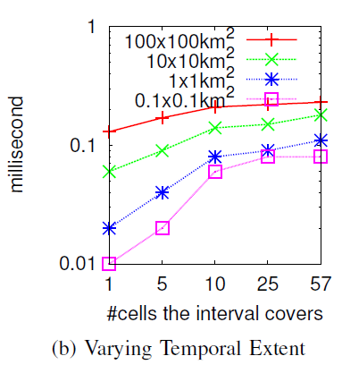
Varying Query Extents

Slide 30
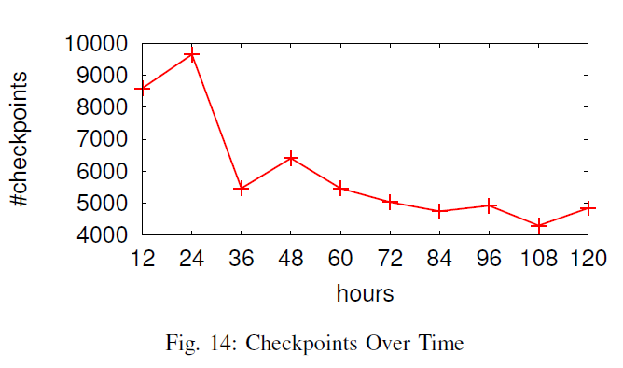
# of checkpoints

Slide 31
Conclusion
They propose a solution for top-k spatio-temporal term querying.
  A new indexing scheme
  Support for dynamic summaries and an algorithm for counting
  A merge algorithm for the summaries.
AFIA’s throughput exceeds Twitter’s current average rate by a factor of 4–10.
One month of dynamic summaries require 120 GB of memory.
The lowest observed accuracy was 97%.

Slide 32
Thank you

