Slide 1
Mining Long, Sharable Patterns in
Trajectories of Moving Objects
Győző Gidófalvi / Torben Bach Pedersen
STDBM 2006, Seoul, South Korea
Saulius Samulevičius

Slide 2
Outline
Moving objects
Spatio-temporal data to spatio-temporal baskets(pivoting)
Trajectories to transactions
Method for mining LSP
Experiments
Conclusions and comments

Slide 3
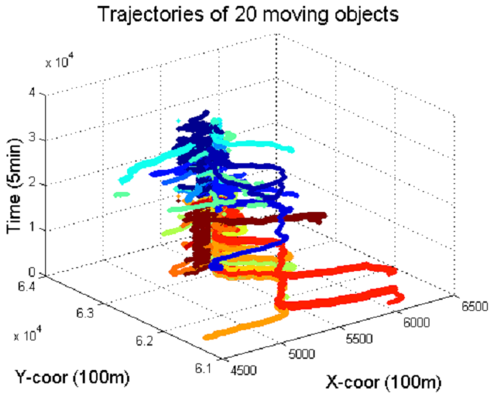
Moving objects
Large amounts of location data from objects (mobile devices, with GPS)
Data is collected as a sequence of points
Extracting patterns for:
  location based services;
  location based advertising
  optimizing storage and
  operations with data
  better tracking of moving
  objects

Slide 4
Outline
Moving objects
Spatio-temporal data to spatio-temporal baskets(pivoting)
Trajectories to transactions
Method for mining LSP
Experiments
Conclusions and comments

Slide 5
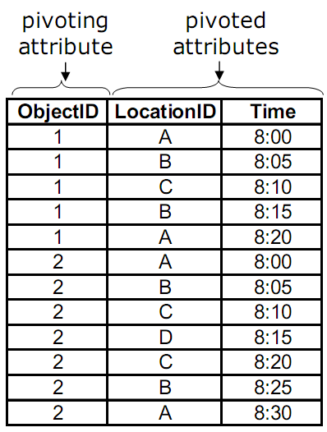
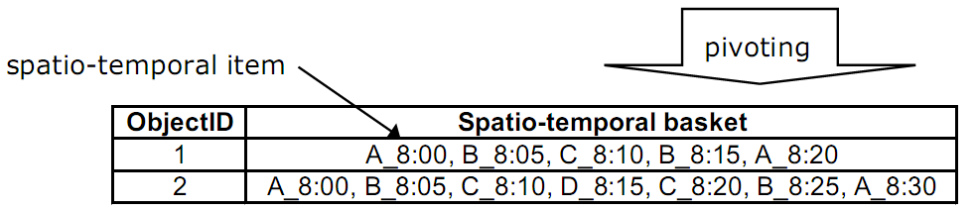
Spatio-temporal data to baskets(pivoting)
Pivoting is the process of grouping a
set of records based on one or more
attributes (pivoting attributes) and
assigning the values of one of more
different attributes (pivoted attributes)
to groups or baskets.
Frequent itemset mining to
discover relationships between items
in the baskets [Agr94]

Slide 6
Outline
Moving objects
Spatio-temporal data to spatio-temporal baskets(pivoting)
Trajectories to transactions
Method for mining LSP
Experiments
Conclusions and comments

Slide 7
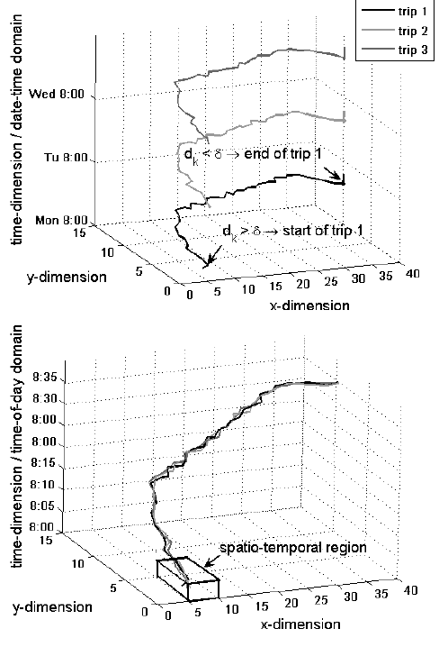
Trajectories to transactions
In three steps
Identify trips: trip starts with k
consecutive GPS displacement > delta,
ends - k consecutive <delta
Identify periods: projection of
temporal dimension f.e. day, week, month
Eliminate noisy data: eliminate GPS
errors by using spatio-temporal regions

Slide 8
Outline
Moving objects
Spatio-temporal data to spatio-temporal baskets(pivoting)
Trajectories to transactions
Method for mining LSP
Experiments
Conclusions and comments

Slide 9
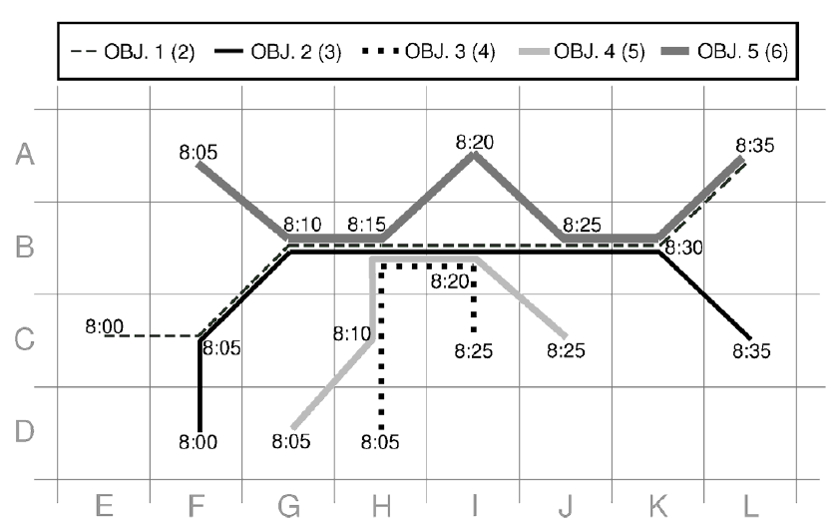
Method for mining LSP
LBS ride sharing application
  Interesting only if routes long (patterns are long)
  Interesting only if shared (patters shared between few customers)
Task: find patterns that
have at least length 4, are
parts of at least 4 trajecto-
ries, which belong to at
least 2 distinct objects

Slide 10
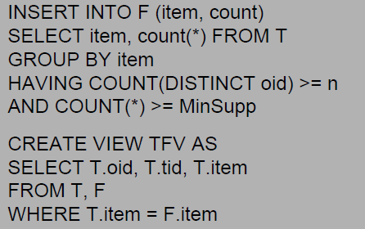
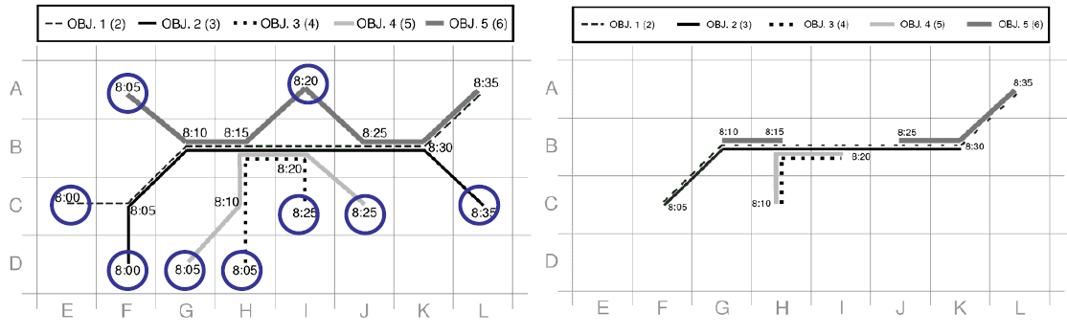
Mining LSP 1: filtering infrequent items
Infrequent items cannot be part
of pattern
An item is frequent if the number of
transactions that contain that item>=
MinSuppp(ex. 4), and the number of
unique objects associated with those
transactions >=n (ex. 2)

Slide 11
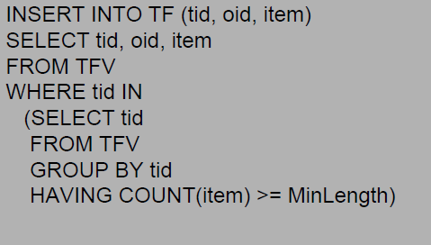
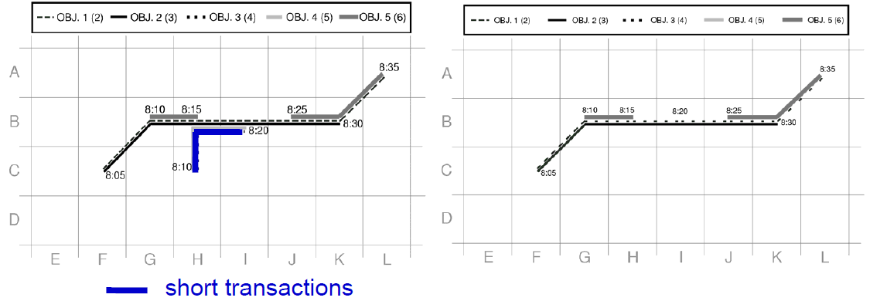
Mining LSP 2: filtering short transactions
Short transaction never will be in
long pattern
A transaction is short if the number
of items in it is less than or equal to
Minlength (ex. 4)

Slide 12
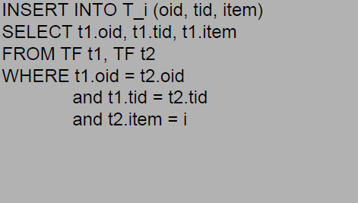
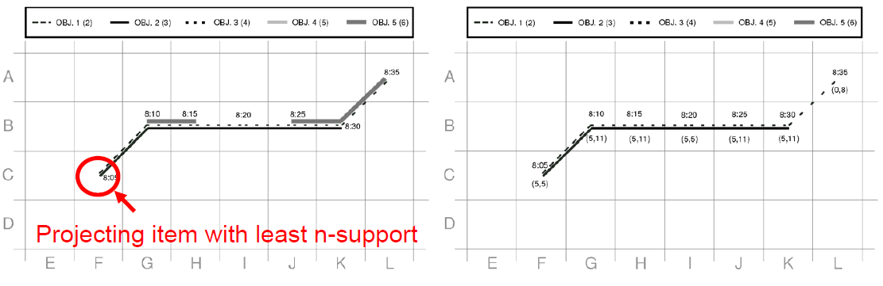
Mining LSP 3: DB projection
An item-projected DB, T_i contains
all items from transactions containing
item i
All patterns that a given item i
participates in can be found in the
item-projected DB, T_i

Slide 13
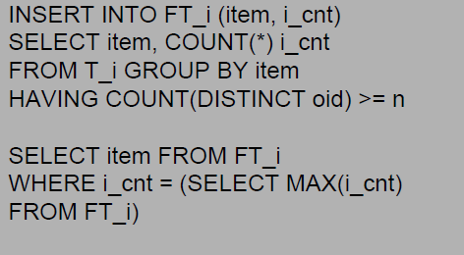
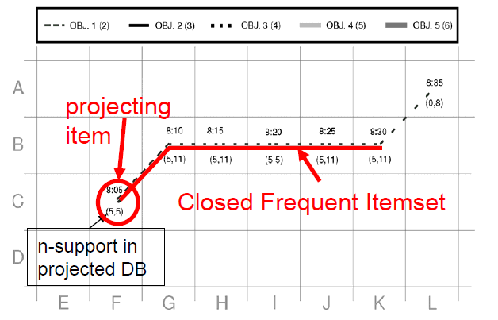
Mining LSP 4: most frequent itemset
A single most frequent itemset in a
projected DB, and its support equal to
the support of the projecting item
If the number of items in this itemset
is greater than or equal to MinLength
then it is a long sharable pattern

Slide 14
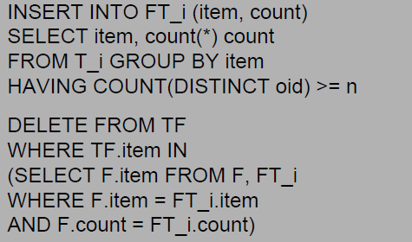
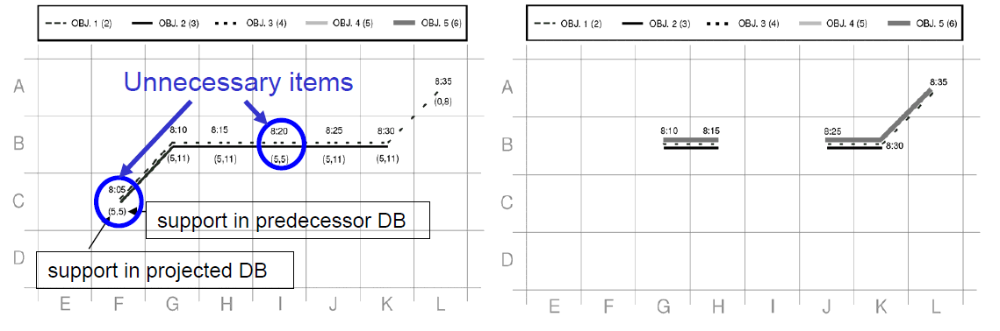
Mining LSP 5: deletion of itemsets
Deletion of unnecessary itemsets
Items that have the same support in
the item projected DB as the projected
DB, can be deleted

Slide 15
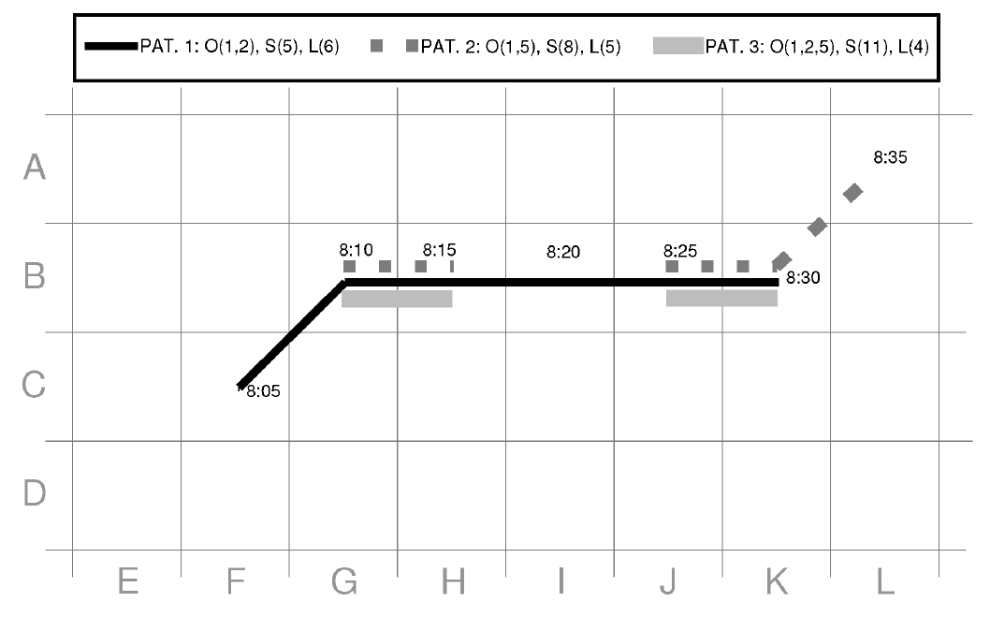
Patterns in the sample DB

Slide 16
Outline
Moving objects
Spatio-temporal data to spatio-temporal baskets(pivoting)
Trajectories to transactions
Method for mining LSP
Experiments
Conclusions and comments

Slide 17
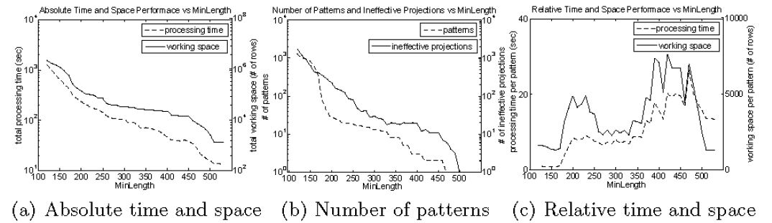
Experiments
Infanti data: 20 cars, 2 months, 1.8mln GPS, 3699 trips
Implemented on MS-SQL
Absolute time and pace performance is exponentially increasing as the MinLength parameter is decreased
Uneven performance is due to the sudden appearance of patterns

Slide 18
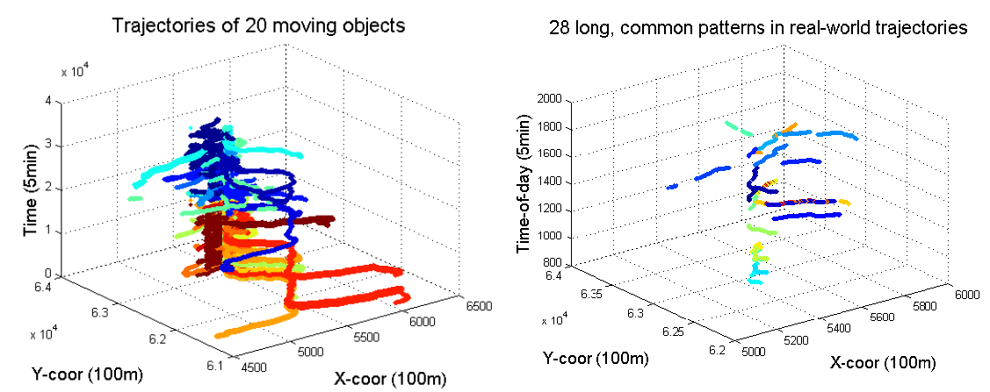
Experiments
Large amount data vs only patterns
Difficult vs easy to analyze

Slide 19
Outline
Moving objects
Spatio-temporal data to spatio-temporal baskets(pivoting)
Trajectories to transactions
Method for mining LSP
Experiments
Conclusions and comments

Slide 20
Conclusions and comments
Results
  Frequent itemset mining can be modified to extract long sharable patterns from trajectories
  SQL is simple, easy to implement/use
Comments about paper:
  Is it interesting sharable part of trajectory
  Are we interested in from point a to point b, or a, (x,y,u,), b

Slide 21
Questions

