Slide 1
Nearest Neighbor Queries
Nick Roussopoulos, Stephen Kelley, Frederic Vincent: Nearest Neighbor Queries. SIGMOD Conference 1995: 71-79
Saulius Samulevičius

Slide 2
Outline
Problem and motivation
Spatial index – R-tree
Nearest neighbor(NN) search
MBR face properties
NN Metrics and algorithm
Experiment results

Slide 3

Problem and Motivation
For a point (A) on the map, find the k NN
Classic NN queries
find the nearest 5* Danish restaurants
Bounded queries
gas station within 10-15 km range
Spatial joins combined with NN
3 NN restaurants to AAU campus/theater
Furthest Neighbors
other distance ordering functions

Slide 4
Outline
Problem and motivation
Spatial index – R-tree
Nearest neighbor(NN) search
MBR face properties
NN Metrics and algorithm
Experiment results

Slide 5
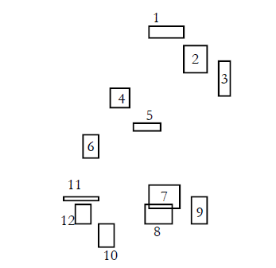
R-tree
Tree construction and use purposes
                Overlap/containment range queries
                Spatial join queries

Slide 6
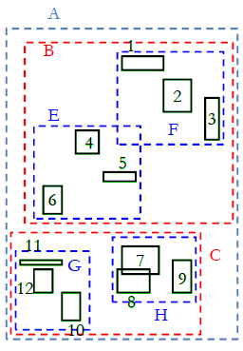
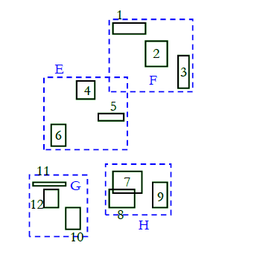
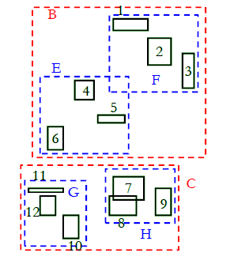
R-tree
Tree construction grouping similar objects

Slide 7
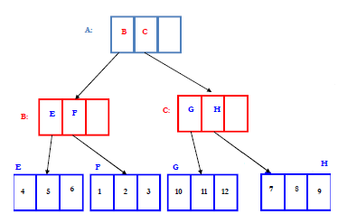
R-tree
Laef nodes – (rect, oid) where rect - MBR, oid - object id
Non-leaf – (rect, p) where p – pointer to successor node
Branching factor/fan-out – max number of elements at node

Slide 8
Outline
Problem and motivation
Spatial index – R-tree
Nearest neighbor(NN) search
MBR face properties
NN Metrics and algorithm
Experiment results

Slide 9
Nearest Neighbor search
Retrieve the nearest neighbor of query point Q
Simple Strategy
  Convert the nearest neighbor search to range search.
  Guess a range around Q that contains at least one object say O
    if the current guess does not include any answers, increase range size until an object found.
  Compute distance d’ between Q and O
  Re‐execute the range query with the distance d’ around Q.
  Compute distance of Q from each retrieved object. The object at minimum distance is the nearest neighbor!!!

Slide 10
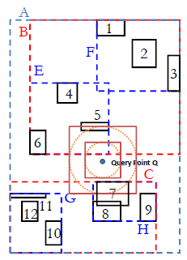
Naïve Approach
Query point Q, how to guess
the range??
Wrong range guessed results
in suboptimal retrieval
Problems in high dimensional
spaces

Slide 11
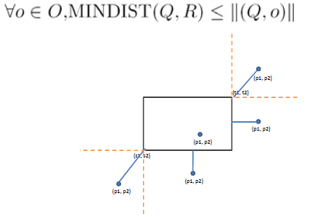
MINDIST property
MINDIST is a lower bound of any k-NN distance

Slide 12
KNN search
A sorted priority queue based on MINDIST;
Nodes traversed in order;
Stops when there is an object at the top of the queue; (1‐NN found)
k‐NN can be computed incrementally;

Slide 13
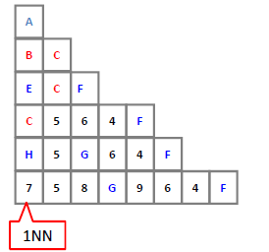
Priority Queue

Slide 14
Outline
Problem and motivation
Spatial index – R-tree
Nearest neighbor(NN) search
MBR face properties
NN Metrics and algorithm
Experiment results

Slide 15
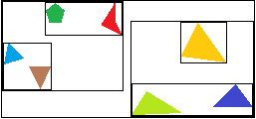
MBR Face property
MBR is an n‐dimensional Minimal Bounding Rectangle used in R trees, which is the minimal bounding n‐dimensional rectangle bounds its corresponding objects.
Every face of any MBR contains at least one point of an actual spatial object
2D

Slide 16
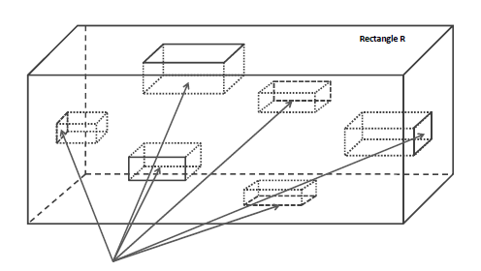
MBR Face property – 3D
Enclosed MBRs or Objects (cuboids)

Slide 17
Outline
Problem and motivation
Spatial index – R-tree
Nearest neighbor(NN) search
MBR face properties
NN Metrics and algorithm
Experiment results

Slide 18
NN Metrics
Minimum Distance (MINDIST)
  MINDIST(P,R): the shortest distance from P(point) to R(MBR)
  Theorem: Any object O in R has distance from P that is at least as large as MINDIST
Minimax Distance (MINMAXDIST)
  MINMAXDIST(P,R) the minimum over all dimensions distance from P to the furthest point of the closest face of the R
  Theorem: There exists at least one object within R with distance <= to MINMAXDIST
MINMAXDIST is an upper bound of the 1-NN distance

Slide 19
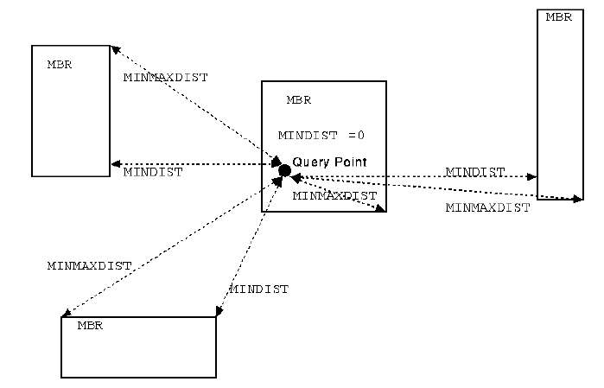
MINDIST & MINMAXDIST
  MINDIST(P,R) <= NN(P) <= MINMAXDIST(P,R)

Slide 20
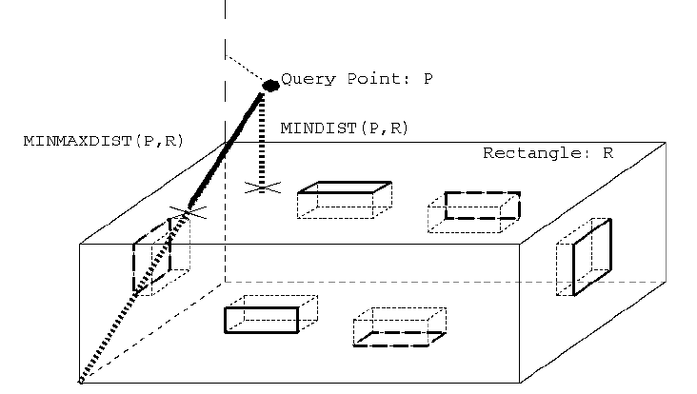
MINDIST & MINMAXDIST in 3-D
  MINDIST(P,R) <= NN(P) <= MINMAXDIST(P,R)

Slide 21
NN Branch-and-Bound Algorithm
  Ordering search alternatives
MINDIST is the most optimistic
MINMAXDIST is the most pessimistic ever needed be considered
Pruning search alternatives
downward pruning(1): an MBR R is discarded if there
exists an R’ such that MINDIST(P,R) > MINMAXDIST(P,R’)
downward pruning(2): an object O is discarded if there
exists an R s.t. ACTUAL-DIST(P,O) > MINMAXDIST(P,R)
upward pruning(3): an MBR R is discarded if an object O
is found s.t. MINDIST(P,R) > ACTUAL-DIST(P,O)

Slide 22
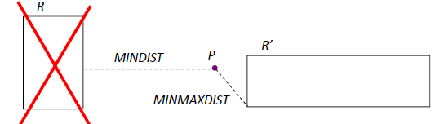
Pruning 1
An MBR R is discarded if there exists an R’ such that MINDIST(P,R) > MINMAXDIST(P,R’)

Slide 23
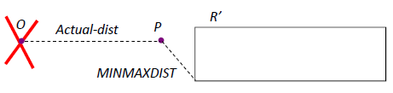
Pruning 2
An object O is discarded if there exists an R such that ACTUAL-DIST(P,O) > MINMAXDIST(P,R)

Slide 24
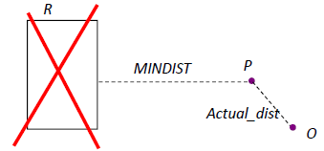
Pruning 3
An MBR R is discarded if an object O is found such that MINDIST(P,R) > ACTUAL-DIST(P,O)

Slide 25
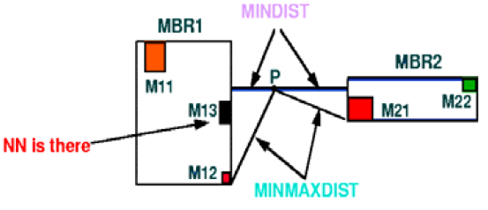
MINDIST vs MINMAXDIST Ordering
MINDIST: optimistic
MINMAXDIST: pessimistic
Example: MINDIST ordering finds the 1‐NN first

Slide 26
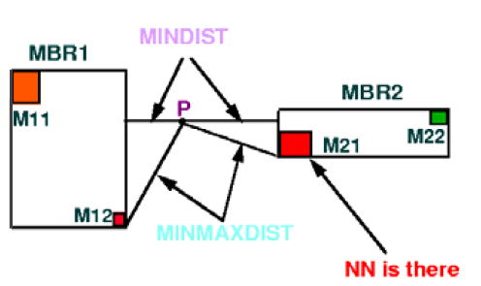
MINDIST vs MINMAXDIST Ordering
MINDIST: optimistic
MINMAXDIST: pessimistic
Example: MINMAXDIST ordering finds the 1‐NN first

Slide 27
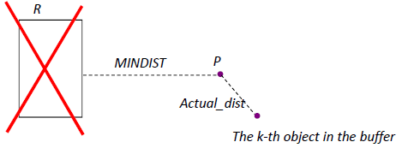
Generalize to k-NN
Keep a sorted buffer of at most k current nearest neighbors
Pruning is done according to the distance of the furthest nearest neighbor in this buffer
Extra pruning based on additional predicates
Example:

Slide 28
Outline
Problem and motivation
Spatial index – R-tree
Nearest neighbor(NN) search
MBR face properties
NN Metrics and algorithm
Experiment results

Slide 29
Experiment Results
Data:
  real (TIGER data sets of Long Beach, CA and Montgomery County, MD)
  Synthetic data sets 1K-256K points
Data sets were sorted according to their Hilbert order and
R-trees were packed using [Rous+Leif1985],[Kame+Falo1993]
Achieved the “maximum” performance for R-tree overlap, containment and NN searches
Comparisons
  Optimistic vs pessimistic ordering
  Scalability in the number of NN
  Scalability in the size of the index

Slide 30
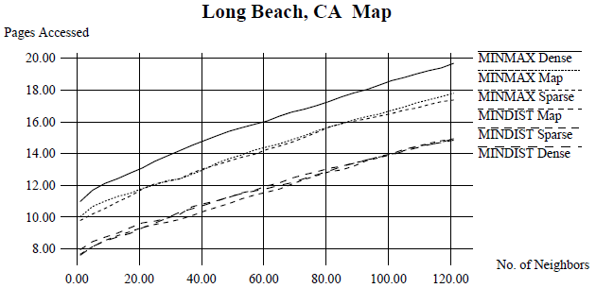
Experiment Results

Slide 31
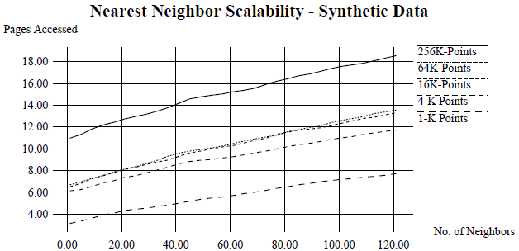
Experiment Results

Slide 32
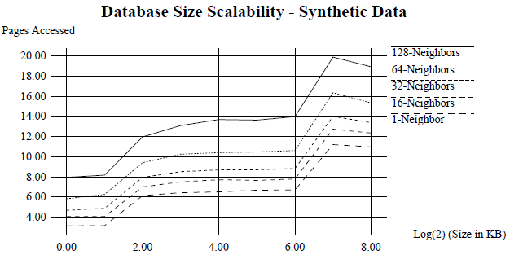
Experiment Results

Slide 33
Conclusions
# of pages accessed grows when k grows;
The denser the dataset, the more page access;
MINDIST vs MINMAXDIST: same in shape, but MINMAXDIST has more I/O cost;
In dense area, MINMAXDIST is bad;
The optimistic MINDIST metric performed better in our experiments but this is related to the construction of the R-trees

Slide 34
Questions

