Slide 1
TrajStore: an Adaptive Storage System for Very Large Trajectory Data Sets
Philippe Cudré-Mauroux
Eugene Wu
Samuel Madden
Computer Science and Artificial Intelligence Laboratory
Massachusetts Institute of Technology
ICDE 2010, March 2, Long Beach, CA, USA

Slide 2

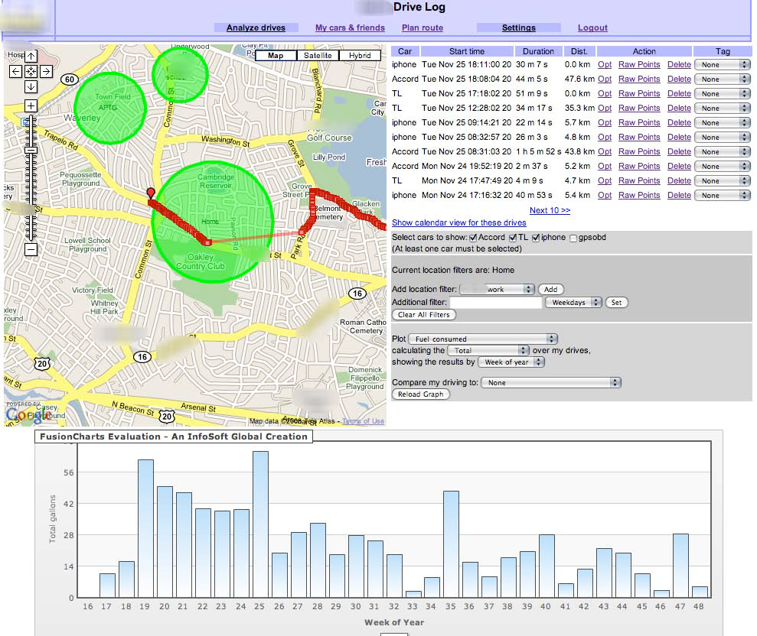
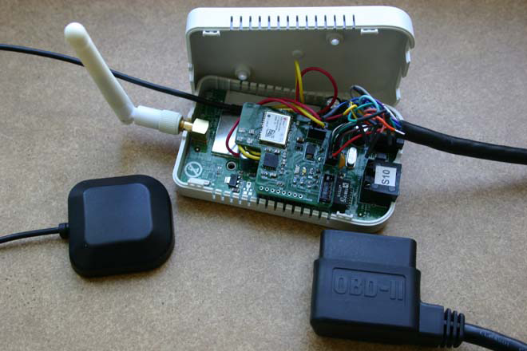
Motivation (1/2)
Explosion of position-aware devices & apps
MIT’s CarTel project (Balakrishnan, Madden)

Slide 3
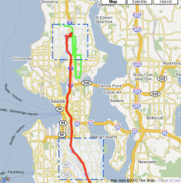
Motivation (2/2)
CarTel
  Massive amounts of GPS data
  Real-time, high insert rates
  Large spatiotemporal queries
New class of applications
    Live feeds from large fleets of mobile objects
Current solutions (e.g., PostGIS) failed
  Designed for (relatively) sparse data

Slide 4
Outline
Motivation
  Large-Scale GPS Data Mining
TrajStore
  Architecture
  Sparse Spatial Index
  Adaptivity
  Compression
Performance

Slide 5
TrajStore
Adaptive system to store & query very large
trajectory data sets
  Sparse, non-overlapping spatial index
  Chunk-based data organization
    co-location, dense-packing & compression
  Buffered, amortized IO operations
Minimization of total IO cost

Slide 6
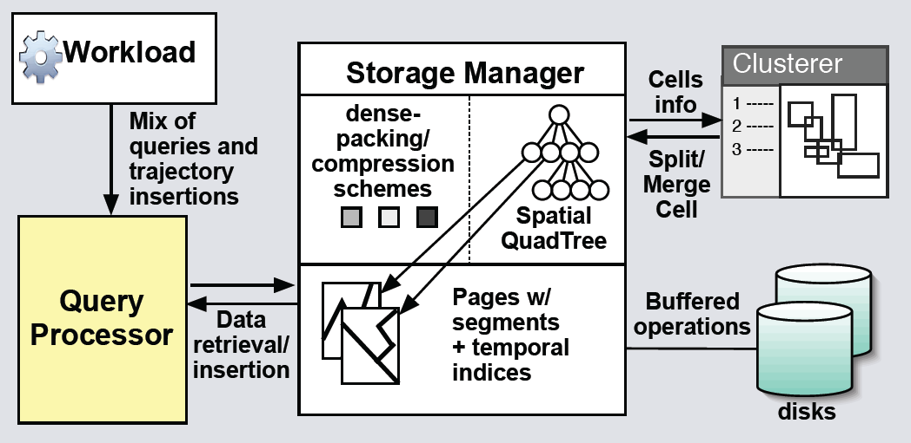
Architecture

Slide 7
OVERVIEW OF APPROACH
query Q(T, r, t)
  where (T) represents a table , (r) a spatial region (in the form of a rectangle), and (t) a temporal range
  Return a set of sub-trajectories within ‘r’ during ‘t’
Table have schema (f₁,f₂,f₃…f_{n}, T_{j})
  Where f₁,f₂,f₃…f_{n} are metadata pertaining to Trajectory T_{j}.
  Metadata may include trajectory ID, userID (collector of data) etc.
Trajectory is a simple vector of (x,y,t) or (x,y,z,t), ordered by timestamp t.

Slide 8
Query processing
Given Q(T, r, t)
  lookup on the spatial index to retrieve the cells overlapping r.
  uses the time-stamp index to find all relevant pages that overlap t within a cell
  fetches the pages from disk and do scans
  a set of (sub-trajectory, time-stamp) pairs
  assembles sub-trajectories from the same trajectory together in time-stamp

Slide 9
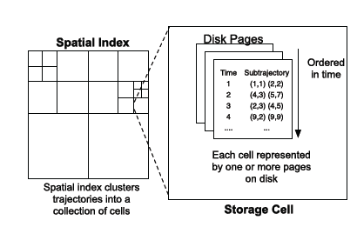
Index & Storage
Spatial index: quadtree
  [new] Optimal quadtree construction
  [new] Adaptive, index-driven data storage

Slide 10


Spatial Index (1/2)
Basic idea
  Cost-model for query execution times based on #cells accessed
  Consider random rectangle queries ‘q’ of size q_{w} X q_{h} on the spatial plane.
  For a homogeneous region cell_{w} X cell_{h} , with a density ‘D’ of
  data points per square unit
where pageSize is max. number data points that a page can contain
*Function above is highly non-linear, cell with no points costs 0, where as cell with number of points from to pageSize costs 1.

Slide 11
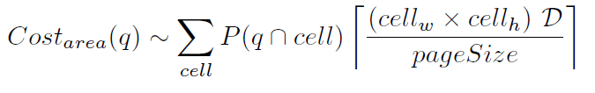

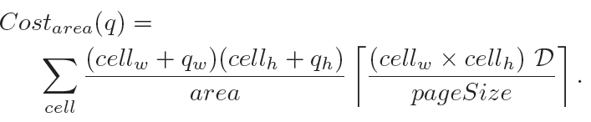
Spatial Index (2/2)
  For a larger homogeneous region of area ‘area’, more cells are needed.
  where is the probablity that random query intersects the cell
  Query ‘q’ intersects cell ‘cell’
    when its center is within a boundies of cell or
    center falls just outside the cell upto distance of q_{w}/2 of vertical edge and q_{h}/2 of horizontal edge
    Final cost expression for ‘q’

Slide 12

Optimal quadtree construction
Optimal quadtree construction based on cost-model, query workload, local density & page size
Limitation:
  Density dependent
  large trajectory data sets are highly skewed in the spatial dimension, as most traces around popular areas (e.g., city centers) and roads, while isolated areas (e.g., forests) are mostly empty
  the density of the data set evolves every time a new trajectory is inserted
  Maintaining an optimal grid size in presence of updates would require repeatedly re-clustering the entire data set

Slide 13
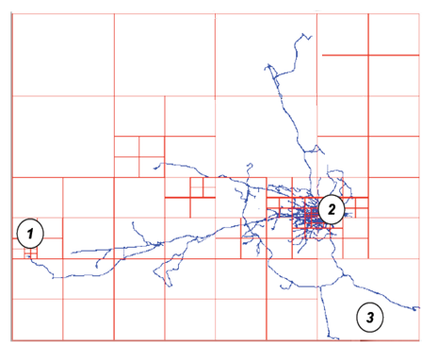
Adaptive multi-level grid approach
recursively splits and merges cells to minimize the number of disk transfer
approach splits regions to minimize empty space in the cells containing segments (point 1)
Cells are also divided in dense areas (point 2)
Optimal balance between
  Oversized cells
    potentially retrieves data that is not queried
  Undersized cells
    unnecessary seeks if dense data and relatively large query
See point (3)

Slide 14
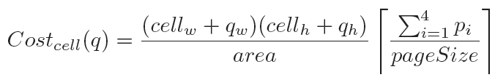
Index Construction
  Each cell is also associated with a cost:
      where p1,…, p4 represents the current number of points in each of the four quadrants of the cell
      first term represents the probability that the cell gets queried, as before

Slide 15
Data evolution
Adapt the index & storage with every incoming trajectory
Three different cases can occur:
  Split
  Merge
  Append
Very fast, incremental operations

Slide 16
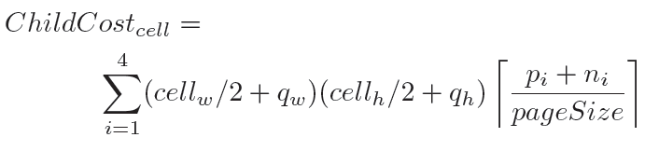
Split
taking into account
    the current number of points (p1,…,p4) contained in the cell
    the points (n1,…,n4) from the new trajectory split by quadrant
the cost associated with the replacement of the current cell by its four children:
new cost smaller than the current cost triggers the split(cell)

Slide 17
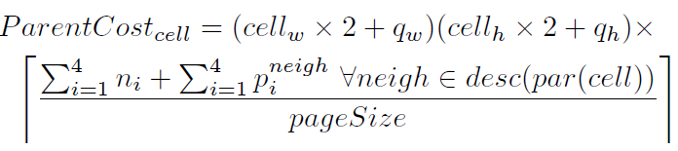
merge
compute the cost associated with the replacement of the current cell and its three siblings (which can themselves contain sub-cells) by a new parent cell:
    where par() retrieves the parent of a cell and
    desc() all the cells in the sub-tree attached to a given parent
Merge routine is called when parent cost is smaller than current cost
happens in sparse areas

Slide 18
append
adding a few segments to a cell does not alter the cost of the cell significantly
simply append the new data to the page corresponding to the cell and update the values of p1,…,p4.
cost penalty is used to avoid splitting or merging
  Split only
    ChildCost_{c} x (1+ Ԑ_{cost}) < Cost_{c}
  Merge only
    PreantCost_{c} x (1 + Ԑ_{cost}) < Cost_{c}

Slide 19

Query Evolution (1/2)
Highly-skewed queries in practice
EWMA-based re-clustering
    Each cell have exponentially weighted moving average (EWMA) query size QS.
    Whenever a cell is queried,
      EWMA recomputed as curQS and save the value along with QS.
      α where is an exponential weighting factor
    When
    |curQS.h X curQS.w – QS.h X QS.w| > t , where t is some size threshold

Slide 20
Query Evolution (2/2)
the cost of a cell is dependent on the query size
Re-clustering simply involves applying the cost formulas for split and merge with q set to curQS

Slide 21
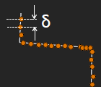
compression
delta compression scheme
a starting coordinate followed by series of delta´s
    Where
key idea is that each of these deltas can be encoded using significantly less space than the original value

Slide 22

Cluster based compression (1/2)
cluster-based lossy compression
  idea is to cluster related sub-trajectories in each cell into cluster groups, and store only one trajectory per group
    Calculating Distances Between Trajectories
    Final distance reported:

Slide 23
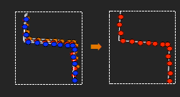
Cluster based compression (2/2)
2. Calculating cluster groups
cluster around central trajectory (t), such that for all trajectories (t´) in the group dist(t,t´) < Ԑ
3. Cluster groups stored
4. Cluster groups updated
*For details about 3 and 4 , see full paper.

Slide 24
Experimental Setup
Query answering on 40-200M GPS readings
  CarTel data
  Large queries (0.1% / 1% / 10%)
Approaches compared
  PostGIS
  Optimal trajectory segmentation
  TrajStore
TrajStore variants
  Fixed grid
  Capacity-bound quadtree
  Compression schemes

Slide 25
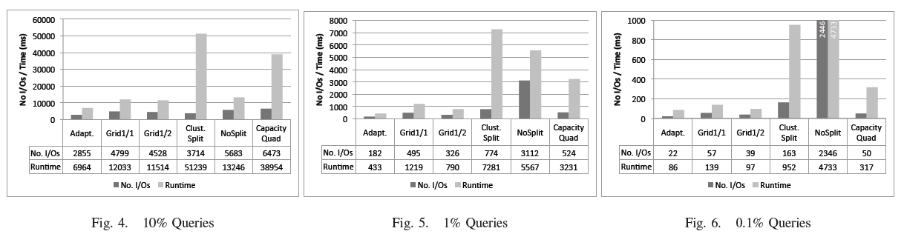
Experiments 1
Experiment 1: Query Size:

Slide 26
Thank you

