Slide 1
Distance Browsing in Spatial Databases
by Gísli R. Hjaltason and Hanan Samet
(University of Maryland)
Presenter: Dalia Kaulakiene (daliak@cs.aau.dk)

Slide 2
Terms
Distance browsing : search in a database on the basis of distance. Also called distance scanning.
Ranking : obtain data objects in their order of distance from a given query object. The ranking may be full or partial (only first k objects).

Slide 3
NN search techniques
Conventional k-NN algorithm (k is known prior to execution).
  if m > k neighbors are needed
Incremental NN algorithm.
  processing complex queries with spatial proximity (e.g., the nearest city to Chicago with population greater than a million)

Slide 4
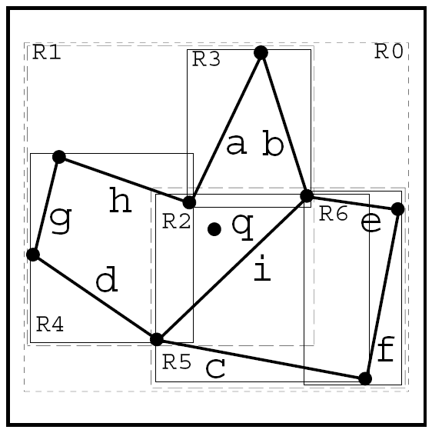
Example
Assume n cities, a query city q.
Primary query: Find the k cities closest to q.
But what if we put a secondary requirement, that a reported city has > 1M citizens.

Slide 5
Approaches
k-NN:
  How to choose an appropriate value of k?
  Repeat redundant calculations if m > k neighbors are needed.
Incremental NN:
  Neighbors are found one-by-one as needed.
  The k+1st neighbor can be found without recalculating the first k NN.

Slide 6
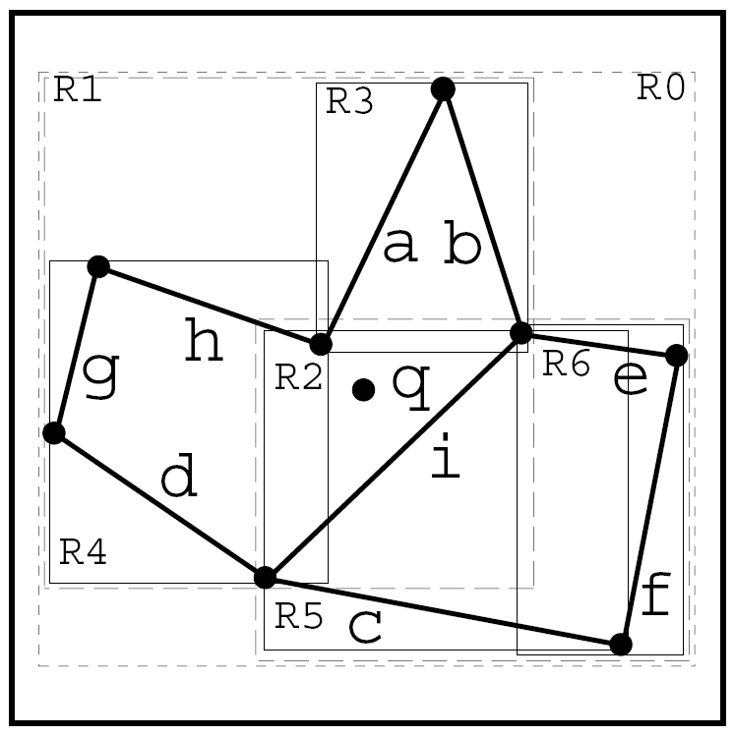
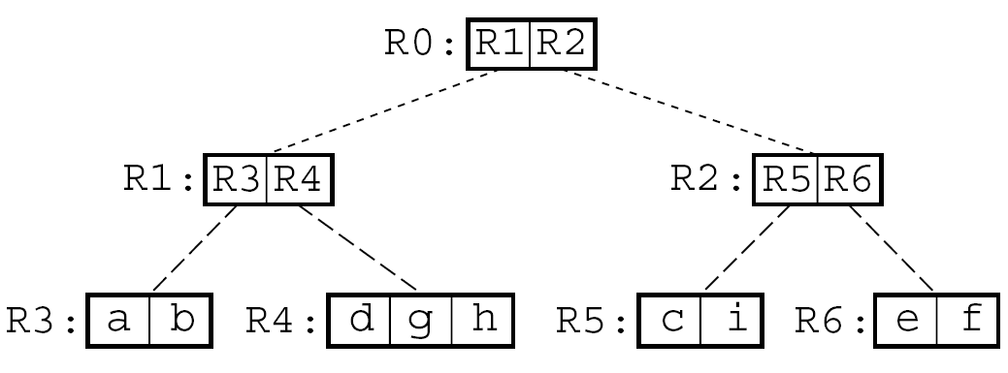
Incremental NN
Incremental NN is for general spatial indexes, but examples are for R-Tree indexing technique.

Slide 7
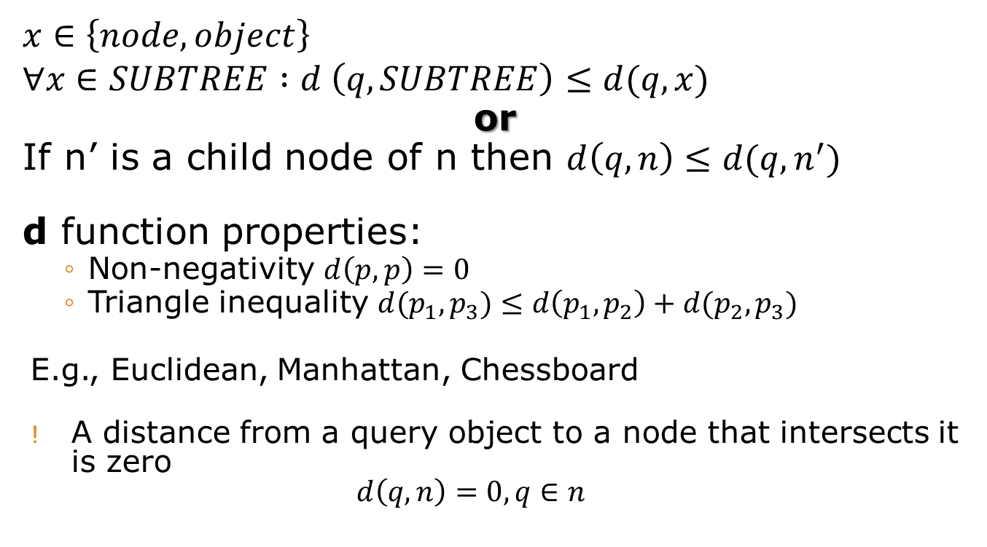
Consistent distance function d
$$x∈\left\{node, object\right\}$$
$$∀x∈SUBTREE :d \left(q, SUBTREE\right)≤d(q,x)$$
or
If n’ is a child node of n then $d\left(q, n\right)≤d(q, n^{′})$
d function properties:
  Non-negativity $d\left(p,p\right)=0$
  Triangle inequality $d(p_{1},p_{3})≤d\left(p_{1},p_{2}\right)+d(p_{2},p_{3})$
E.g., Euclidean, Manhattan, Chessboard
A distance from a query object to a node that intersects it is zero
$d\left(q,n\right)=0, q∈n$

Slide 8
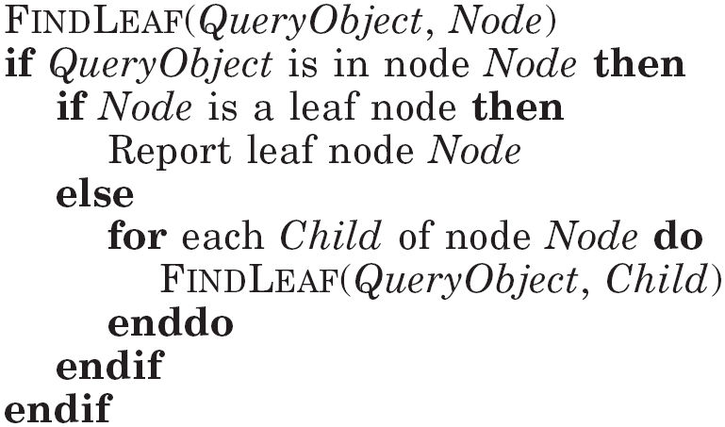
Top-down traversal
When the Node is found:
the object, closest to the QueryObject might be in another node;
it does not help in finding the next nearest node

Slide 9
Solution
Replace recursion stack with a priority queue:
  The key in priority queue is the distance from the query object.
  Use the priority queue for nodes and for objects!
  Nodes are ordered before objects (when distance is the equal)
    no object is reported more than 1 time.
Use best-first tree traversal (common practice is depth-first or breadth-first).

Slide 10
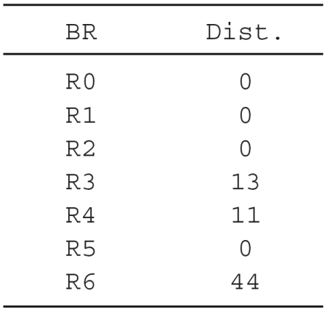
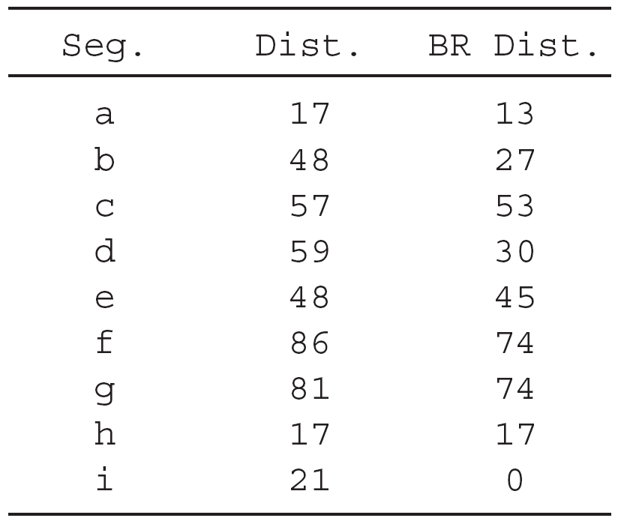
Example

Slide 11
Example
The priority queue:
{(R1, 0), (R2, 0)}

Slide 12
Example
The priority queue:
{(R1, 0), (R2, 0)}
{(R2, 0), (R4, 11), (R3, 13)}

Slide 13
Example
The priority queue:
{(R1, 0), (R2, 0)}
{(R2, 0), (R4, 11), (R3, 13)}
{(R5, 0), (R4, 11), (R3, 13), (R6, 44)}

Slide 14
Example
The priority queue:
{(R1, 0), (R2, 0)}
{(R2, 0), (R4, 11), (R3, 13)}
{(R5, 0), (R4, 11), (R3, 13), (R6, 44)}
{([i], 0), (R4, 11), (R3, 13), (R6, 44), ([c], 53)}

Slide 15
Example
The priority queue:
{(R1, 0), (R2, 0)}
{(R2, 0), (R4, 11), (R3, 13)}
{(R5, 0), (R4, 11), (R3, 13), (R6, 44)}
{([i], 0), (R4, 11), (R3, 13), (R6, 44), ([c], 53)}
{(R4, 11), (R3, 13), (i, 21), (R6, 44), ([c], 53)}

Slide 16
Example
The priority queue:
{(R1, 0), (R2, 0)}
{(R2, 0), (R4, 11), (R3, 13)}
{(R5, 0), (R4, 11), (R3, 13), (R6, 44)}
{([i], 0), (R4, 11), (R3, 13), (R6, 44), ([c], 53)}
{(R4, 11), (R3, 13), (i, 21), (R6, 44), ([c], 53)}
{(R3, 13), ([h], 17), (i, 21), ([d], 30), (R6, 44), ([c], 53), ([g], 74)}

Slide 17
Example
The priority queue:
{(R1, 0), (R2, 0)}
{(R2, 0), (R4, 11), (R3, 13)}
{(R5, 0), (R4, 11), (R3, 13), (R6, 44)}
{([i], 0), (R4, 11), (R3, 13), (R6, 44), ([c], 53)}
{(R4, 11), (R3, 13), (i, 21), (R6, 44), ([c], 53)}
{(R3, 13), ([h], 17), (i, 21), ([d], 30), (R6, 44), ([c], 53), ([g], 74)}
{([a], 13), ([h], 17), (i, 21), ([b], 27), ([d], 30), (R6, 44), ([c], 53), ([g], 74)}

Slide 18

The priority queue:
{(R1, 0), (R2, 0)}
{(R2, 0), (R4, 11), (R3, 13)}
{(R5, 0), (R4, 11), (R3, 13), (R6, 44)}
{([i], 0), (R4, 11), (R3, 13), (R6, 44), ([c], 53)}
{(R4, 11), (R3, 13), (i, 21), (R6, 44), ([c], 53)}
{(R3, 13), ([h], 17), (i, 21), ([d], 30), (R6, 44), ([c], 53), ([g], 74)}
{([a], 13), ([h], 17), (i, 21), ([b], 27), ([d], 30), (R6, 44), ([c], 53), ([g], 74)}
$d\left(q,a\right)≤d(q,\left[h\right])$ - a is reported as nearest neighbor to q.

Slide 19

The priority queue:
{(R1, 0), (R2, 0)}
{(R2, 0), (R4, 11), (R3, 13)}
{(R5, 0), (R4, 11), (R3, 13), (R6, 44)}
{([i], 0), (R4, 11), (R3, 13), (R6, 44), ([c], 53)}
{(R4, 11), (R3, 13), (i, 21), (R6, 44), ([c], 53)}
{(R3, 13), ([h], 17), (i, 21), ([d], 30), (R6, 44), ([c], 53), ([g], 74)}
{([a], 13), ([h], 17), (i, 21), ([b], 27), ([d], 30), (R6, 44), ([c], 53), ([g], 74)}
$d\left(q,a\right)≤d(q,\left[h\right])$ - a is reported as nearest neighbor to q.
h is 2nd NN and i is 3rd NN with very little additional effort!
R6 is left on the priority queue at the end of the execution, i.e. that subtree is pruned by the algorithm.

Slide 20
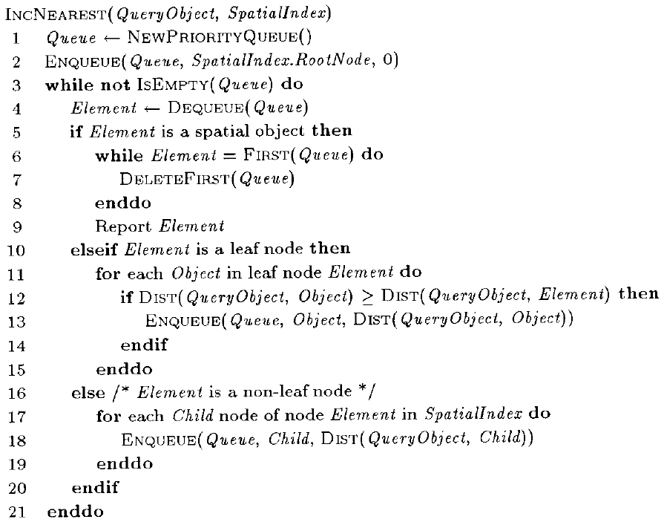
Incremental NN

Slide 21
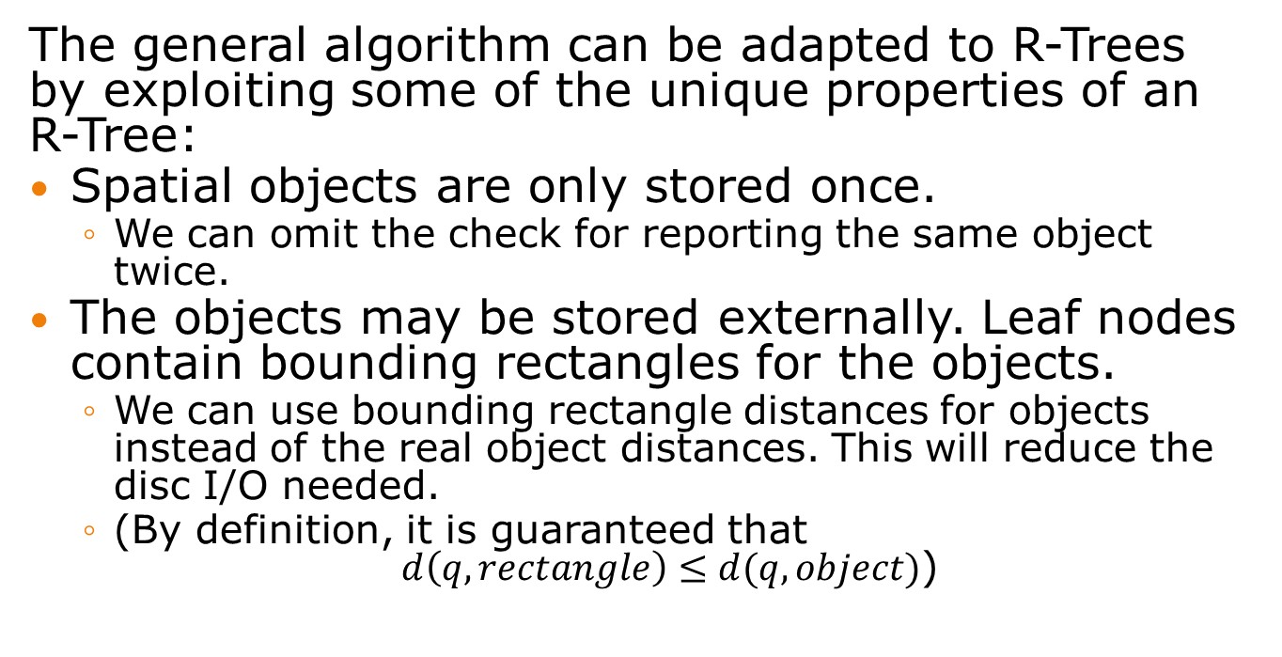
Incremental NN optimization
The general algorithm can be adapted to R-Trees by exploiting some of the unique properties of an R-Tree:
Spatial objects are only stored once.
  We can omit the check for reporting the same object twice.
The objects may be stored externally. Leaf nodes contain bounding rectangles for the objects.
  We can use bounding rectangle distances for objects instead of the real object distances. This will reduce the disc I/O needed.
  (By definition, it is guaranteed that
  $d\left(q,rectangle\right)≤d(q,object)$)

Slide 22
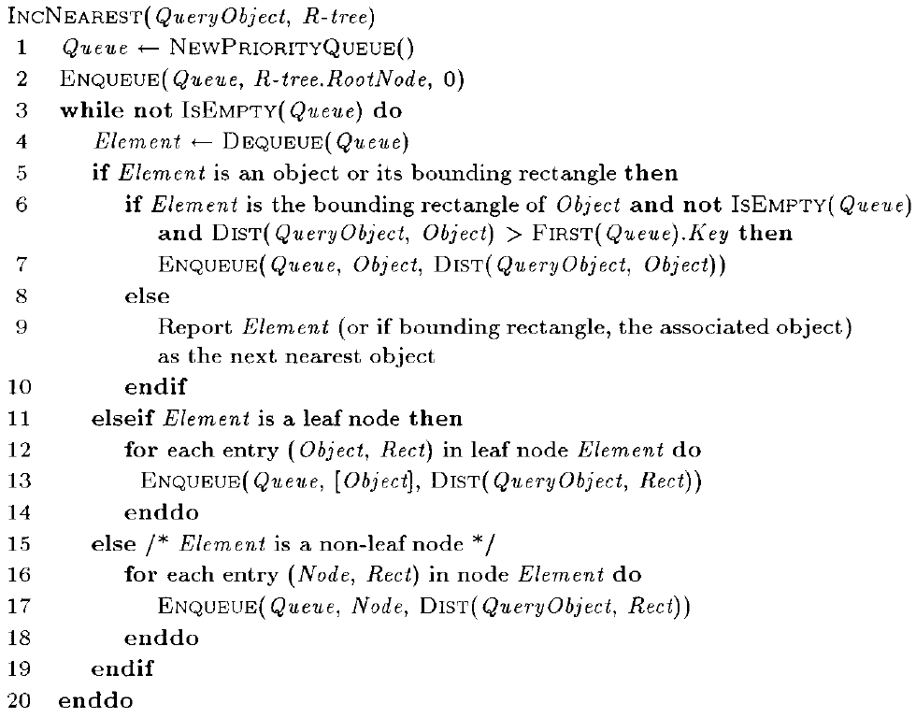
Incremental NN for R-trees
No pruning here!

Slide 23
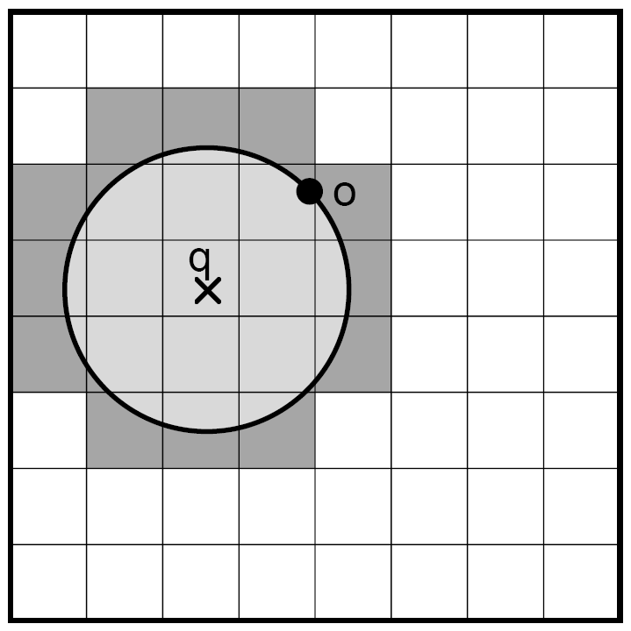
Example (2)
Locate leafnodes, containing
q.
Search region (from radius 0
to .. ).
Each time the circle hits the
boundary of a search region,
the contents of that node are
put on a queue.
All nodes inside the search region has been examined.
When hitting an object, we have found the next nearest object to q.

Slide 24
k-NN search algorithm
Applicable when k is fixed in advance.
Key idea: Maintain a global candidate list with the k nearest neighbors so far as the R-Tree is traversed.
Uses depth-first traversal of the R-Tree.
  Only able to make local decisions about which node to visit next, i.e. next node has to be a child node of the current node.
  (The incremental algorithm was able to make global decisions).

Slide 25
Example k-NN
Find 3 neighbors

Slide 26
Example k-NN
Find 3 neighbors
k-NN(R0): ABList(R0) = (R1, R2)

Slide 27
Example k-NN
Find 3 neighbors
k-NN(R0): ABList(R0) = (R1, R2)
  k-NN(R1): ABList(R1) = (R4, R3)

Slide 28
Example k-NN
Find 3 neighbors
k-NN(R0): ABList(R0) = (R1, R2)
  k-NN(R1): ABList(R1) = (R4, R3)
    k-NN(R4): NList = {(h, 17), (d, 59), (g, 81)}

Slide 29
Example k-NN
Find 3 neighbors
k-NN(R0): ABList(R0) = (R1, R2)
  k-NN(R1): ABList(R1) = (R4, R3)
    k-NN(R4): NList = {(h, 17), (d, 59), (g, 81)}
    k-NN(R3): NList = {(h, 17), (a, 17), (b, 48)}

Slide 30
Example k-NN
Find 3 neighbors
k-NN(R0): ABList(R0) = (R1, R2)
  k-NN(R1): ABList(R1) = (R4, R3)
    k-NN(R4): NList = {(h, 17), (d, 59), (g, 81)}
    k-NN(R3): NList = {(h, 17), (a, 17), (b, 48)}
  k-NN(R2): ABList(R2) = (R5, R6)

Slide 31
Example k-NN
Find 3 neighbors
k-NN(R0): ABList(R0) = (R1, R2)
  k-NN(R1): ABList(R1) = (R4, R3)
    k-NN(R4): NList = {(h, 17), (d, 59), (g, 81)}
    k-NN(R3): NList = {(h, 17), (a, 17), (b, 48)}
  k-NN(R2): ABList(R2) = (R5, R6)
    k-NN(R5): NList = {(h, 17), (a, 17), (i, 21)}

Slide 32
Example k-NN
Find 3 neighbors
k-NN(R0): ABList(R0) = (R1, R2)
  k-NN(R1): ABList(R1) = (R4, R3)
    k-NN(R4): NList = {(h, 17), (d, 59), (g, 81)}
    k-NN(R3): NList = {(h, 17), (a, 17), (b, 48)}
  k-NN(R2): ABList(R2) = (R5, R6)
    k-NN(R5): NList = {(h, 17), (a, 17), (i, 21)}
    k-NN(R6): d(q, R6) ≥ 21, so this invocation does not occur.

Slide 33
Find 3 neighbors
k-NN(R0): ABList(R0) = (R1, R2)
  k-NN(R1): ABList(R1) = (R4, R3)
    k-NN(R4): NList = {(h, 17), (d, 59), (g, 81)}
    k-NN(R3): NList = {(h, 17), (a, 17), (b, 48)}
  k-NN(R2): ABList(R2) = (R5, R6)
    k-NN(R5): NList = {(h, 17), (a, 17), (i, 21)}
    k-NN(R6): d(q, R6) ≥ 21, so this invocation does not occur.
{(h, 17), (a, 17), (i, 21)} is returned as the 3 nearest neighbors of q.

Slide 34
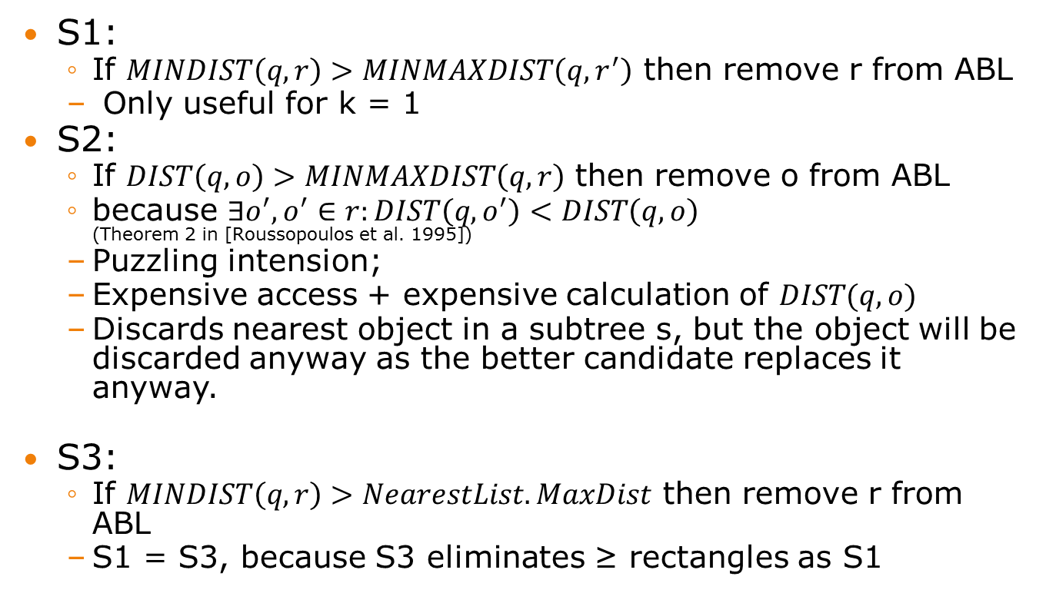
k-NN pruning strategies
S1:
  If $MINDIST\left(q,r\right)>MINMAXDIST\left(q,r^{′}\right)$ then remove r from ABL
  Only useful for k = 1
S2:
  If $DIST\left(q,o\right)>MINMAXDIST\left(q,r\right)$ then remove o from ABL
  because $∃o^{′}, o^{′}∈r:DIST\left(q,o^{′}\right)<DIST\left(q,o\right)$
  (Theorem 2 in [Roussopoulos et al. 1995])
  Puzzling intension;
  Expensive access + expensive calculation of $DIST(q,o)$
  Discards nearest object in a subtree s, but the object will be discarded anyway as the better candidate replaces it anyway.
S3:
  If $MINDIST\left(q,r\right)>NearestList.MaxDist$ then remove r from ABL
  S1 = S3, because S3 eliminates ≥ rectangles as S1

Slide 35
Comparison
Incremental algorithm will generally achieve more pruning than k-NN, but never less.
When nearest is found, additional few can be retrieved with virtually no additional work
Optimization for memory/disk based priority queue when
  Large number of dimensions
  Complex objects (not points)
  Very skewed data distributions
Better performance in experiments (execution time, disk I/O, number of distance computations, varying sizes of data sets)

Slide 36
Summary
Incremental algorithm:
  Finding the next nearest neighbor one-by-one.
  No need to start from scratch when finding the k+1st neighbor.
k-NN algorithm:
  Using a predefined k.
  Has to redo the whole execution when wants to find the k+1st neighbor after having found the k nearest neighbors.
The incremental approach generally performs much better.

Slide 37
Thank you!

