Slide 1
Modeling Massive RFID Data Sets: A Gateway-Based Movement Graph Approach
Hector Gonzalez, Jiawei Han, Hong Cheng, Xiaolei Li, Diego Klabjan, Tianyi Wu, IEEE Trans. Knowl. Data Eng. 22(1): 90-104 (2010)
Presented By
-Tanvir Ahmed

Slide 2
Outline
Motivation
Contribution
RFID Data
Gateway-Based Movement Graph
Data Compression
Movement Graph Partitioning
Storage Model
Materialization Strategy
RFID Cube
Experimental Evaluation
Conclusions

Slide 3
Motivation
Massive RFID data sets are expected to become commonplace in supply chain
Warehousing and mining RFID data is an essential problem with great potential benefits for
  Inventory management
  Object Tracking
  Product procurement processes
Need to develop compact and efficient RFID cube model for answering OLAP queries on both spatiotemporal and item information dimension

Slide 4
Example Scenario
A large retailer store with global supplier and distribution network
Sells millions of items per day through thousands of stores around the world
For each item it records the complete set of movement
  Starting at factories in producing countries and finally arriving at particular store
  Also for each object movement shipping cost, temperature and humidity can be recorded

Slide 5
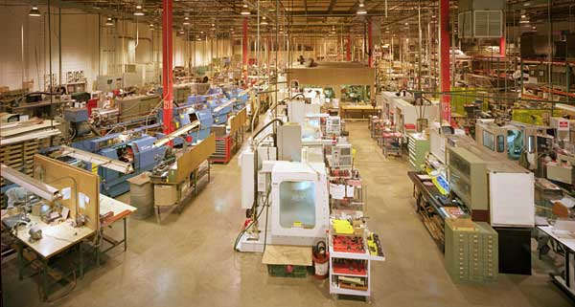
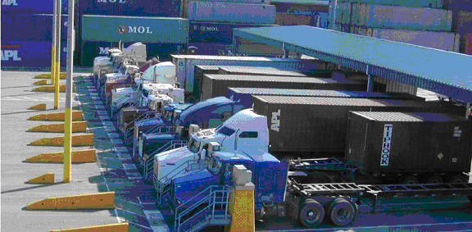
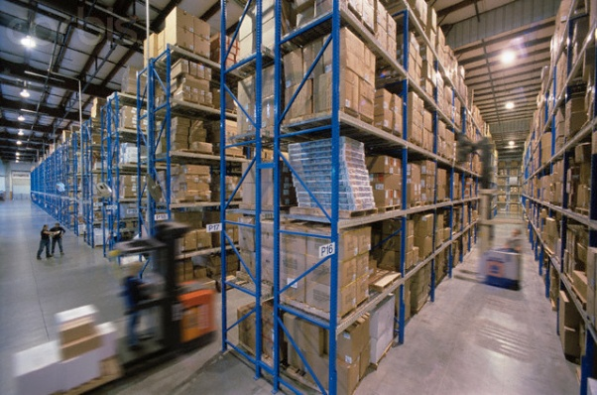

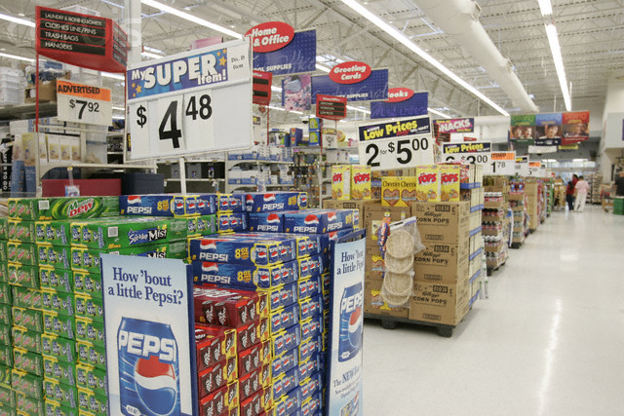
Example Trajectory
(Factory, T₁,T₂)
(Shipping,T₃,T₄)
(Warehouse, T₅,T₆)
(Self, T₇,T₈)
(Checkout,T₉,T₁₀)

Slide 6
Example Query
High-level aggregate/OLAP query: What is the average shipping cost of transporting electronic goods from factories in shanghai to stores in san Francisco in 2007? And then click to drill-down to month and see the trend.
Path query: Print the transportation paths for beef products from Argentina sold in California on 5 April that were exposed to over 40 degree centigrade heat for over 5 hours on the route.

Slide 7
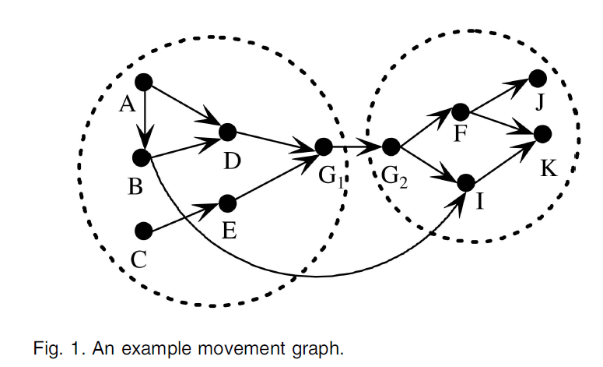
Movement Graph
A directed graph G(V,E)
  V is set of location and E is set of transitions between locations
E(i,j) indicates objects moved from location v_{i} to v_{j}.
Each edge is annotated with the history of object movements.
  Each history is a tuple of the form (t_{start}, t_{end}, tag_list:measure_list)
  Where all the objects in the taglist took the transition together starting at t_{start} and ending at time t_{end} and measure_list records properties of the shipment.

Slide 8
Summery of proposed Architecture
Items movement is recorded in the database and based on the structure of the paths movement graph is constructed.
The path is partitioned along the gateway nodes
Each partition is cubed independently
Query processing module answer OLAP queries over aggregated movement graph

Slide 9
Outline
Motivation
Contribution
RFID Data
Gateway-Based Movement Graph
Data Compression
Movement Graph Partitioning
Storage Model
Materialization Strategy
RFID Cube
Experimental Evaluation
Conclusions

Slide 10
Contribution
Gateway-based partitioning of the movement
  Example: most items travel from China to USA by going through major shipping ports in both countries
  Efficient graph partition algorithm is developed
Redundancy elimination compression
  Store (EPC, location, time_in , time_out) instead of storing each records (EPC, location, time).
  Huge lossless compression
Partition-based bulky movement compression
  Register a single record for thousands of items that stay and move together
  Propose a partitioned map table, that creates a separate mapping for each partition, rooted at major shipping ports
Movement graph aggregation
  Can be aggregated into different levels of abstraction according to the location concept hierarchy
  Different types of aggregation mechanism compared to traditional data cubes as nodes and edges in the graph can be merged and collapsed

Slide 11
Outline
Motivation
Contribution
RFID Data
Gateway-Based Movement Graph
Data Compression
Movement Graph Partitioning
Storage Model
Materialization Strategy
RFID Cube
Experimental Evaluation
Conclusions

Slide 12
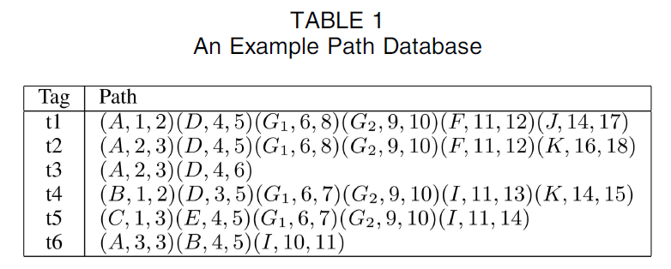
RFID Data
Data Generation
  Generates a stream of tracking records of the form (EPC, location, time)
  Huge amount of data can be reduced by maintaining only the records in the following format (EPC, location, time_in , time_out)
  Sorting the tag readings on EPC a path database is generated of the form: (EPC,(l₁, time_in₁ , time_out₁) (l₂, time_in₂ , time_out₃)…. (l_{k}, time_in_{k} , time_out_{k}))

Slide 13
RFID Data Continue…
Other information of items can be represented as : (EPC, d_{1,} d_{2,…,} d_{m})
  d_{i} is a particular value for dimension D_{i} (e.g product type, manufacturer, weight or price).
In case of shipment extra measurement or properties can be stored with the form : (from , to, t₁, t₂, taglist: measure_list)
  from and to are the initial and final location of the shipment.
  t₁ and t₂ are the starting and ending time of the shipment
  Taglist is the set of items transported,
  Measure_list describes properties such as temperature , humidity, or shipping cost

Slide 14
RFID Data Continue…
Data Cubing Challenges
Suppose a fact table with dimensions (EPC,location, time_in, time_out: measure).
  It can answer: “the number of items that stayed at a given location for a given month”
  The problem : Does not consider links between the records.
  Example Problem: “the number of items of type “dairy product” that traveled from the distribhution center in Chicago to stores in Urbana” we cannot get this information.
  Why?: We have the count of “dairy products” for each location but we do not know how many of these items went from the first location to the second.
  Solution: problem could be solved by increasing the number of dimensions but the size of the data cube grows exponentially.
We need a model capable of aggregating RFID data concisely while preserving its path-like structure for OLAP analysis

Slide 15
Outline
Motivation
Contribution
RFID Data
Gateway-Based Movement Graph
Data Compression
Movement Graph Partitioning
Storage Model
Materialization Strategy
RFID Cube
Experimental Evaluation
Conclusions

Slide 16
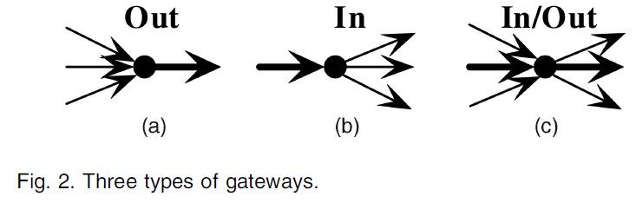
Gateway-Based Movement Graph
Naturally partition the movement graph
  Improve query processing
  Reduce cost of cube computation
Out-Gateway
  Low ratio of average incoming shipment size to average outgoing shipment size.
  High ration to average incoming to outgoing edges.
In-Gateway
  Symmetric complement of Out-Gateway
In-Out-Gateway
  Combination of in and out gateway
  In-gateway for imported raw materials
  Out-gateway for exported manufactured goods.
  Can be separated based on incoming and outgoing edges carrying the same subset of items
May have hierarchy : Country level sea ports -> region level distributin centers -> state level hubs

Slide 17
Outline
Motivation
Contribution
RFID Data
Gateway-Based Movement Graph
Data Compression
Movement Graph Partitioning
Storage Model
Materialization Strategy
RFID Cube
Experimental Evaluation
Conclusions

Slide 18
Data Compression
Redundancy Elimination Compression
  Store (EPC, location, time_in , time_out)
Bulky Movement Compression
  (gid, prod, loc_{A}, t₁,t₂, 1000)
  gid will point to other gids for these 1000 items if they split into more partitions
  Split-only Model: factories -> warehouses -> distribution centers -> large number of stores
  Merge-Split Model: Movement between importing and exporting countries
    Partition the movement graph around gateways

Slide 19
Data Compression Continue…
Data Generalization
Item based: does not involve spatiotemporal dimensions
Path based: New type of data generalization, not presented in traditional data cube
  Merging and collapsing path stages according to time and locating hierarchies
  Also depends on the target of analysis e.g., Transport manager, Store manager

Slide 20
Outline
Motivation
Contribution
RFID Data
Gateway-Based Movement Graph
Data Compression
Movement Graph Partitioning
Storage Model
Materialization Strategy
RFID Cube
Experimental Evaluation
Conclusions

Slide 21
Movement Graph Partitioning
Gateway Identification
  Can be provided by the data analyst
  Sometimes need to discover automatically
  How?
  Take a movement graph and rank nodes based on the following 3 observation:
    Large volume of traffic goes through gateway nodes
    Gateway carry unbalanced traffic
    Gateway splits paths into largely disjoint sets

Slide 22
Movement Graph Partitioning Continue…
How gateway finding algorithm works:
  First eliminate low-traffic nodes
  Then eliminate the nodes with balanced traffic (checking #of incoming and outgoing edges and the ratio of their shipment sizes)
  Finally, for the edges that pass the above two filters, check which locations split the paths going through the location into two largely disjoint sets; (e.g locations occurring in the path before the gateway and those occurring in the path after the gateway)

Slide 23
Movement Graph Partitioning Continue…
Partitioning Algorithm
Key Idea: Very few items in Europe reach the major ports in USA without first having gone through Europe’s main shipping ports
  Associate each location to a set of gateways that it directly reaches
  If locatin l_i and l_j have a gateway in common merge their groups into a single partition containing l_i and l_j and their associated gateways

Slide 24
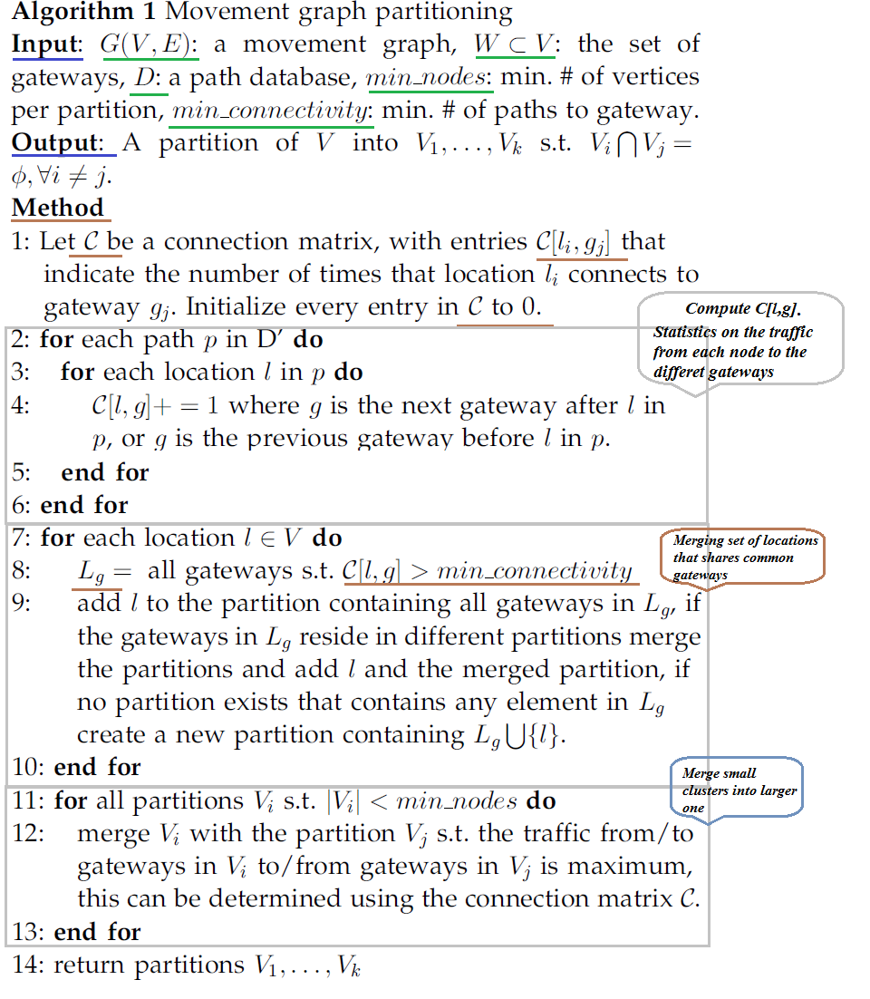

Slide 25
Movement Graph Partitioning Continue…
Handling Irregular Movements: Virtual Gateways
  Few items bypass gateways
  Solved by virtual gateways
  Example (In figure 1): Need to create a virtual gateway G_{x} to send outgoing traffic from first partition (i.e., traffic from B) that skip G₁ and G_{y} to receive incoming traffic into second partition (i.e., traffic to I) that skip G₂
  Guarantee path related query by looking at gateway-related path traffic only.

Slide 26
Outline
Motivation
Contribution
RFID Data
Gateway-Based Movement Graph
Data Compression
Movement Graph Partitioning
Storage Model
Materialization Strategy
RFID Cube
Experimental Evaluation
Conclusions

Slide 27
Storage Model
Edge Table
  (From, to, t_start, t_end, direct, gid_list:measure_list)
Map Table
  (partion, gid, contained_list, contains_list)
  contained_list is the list of all gids with a list of items that is a superset of the items gid, and
  Contains_list is the list gids with item lists that are a subset of gid, or a list of individual tags if gid did not split into smaller groups.
  Reasons:
  1) Compression: 10,000 items moves into 4 stages 10,000, 1,000, 100, 10. Instead of storing 40,000 units store 1,111 unit (1,000 for the last stage and 100, 10, and 1 for the ones before)
  2) Query Processing:
    GID list is much shorter than EPC list.
    Compute Path related query very quickly
    To find the average duration for milk to move from the distribution center (D), to the store backroom (B), and finally to the shelf (S), we need to locate the edge records for milk between the stages and intersect the EPC lists of each.
Path independent information
  (gid_list, D_{1,} D_{2,…,} D_{n})

Slide 28
Outline
Motivation
Contribution
RFID Data
Gateway-Based Movement Graph
Data Compression
Movement Graph Partitioning
Storage Model
Materialization Strategy
RFID Cube
Experimental Evaluation
Conclusions

Slide 29
Materialization Strategy
Path Queries
q <- (σ_{c}info, path_expression, measure)
Example: σ_{c}info= {product = beef, sale_date = 2006}, path_expression={Argentina farm A, San Mateo store S}, and measure = average temperature
  retrieve the appropriate tag lists and measures for the edges along the paths involving the locations in the path expression;
  retrieve the tag list for the items matching the info selection;
  intersect the lists to get the set of relevant tags; and
  finally, if needed, retrieve the relevant paths to compute the measure.

Slide 30
Materialization Strategy Continue…
Path Segment Materialization
  Materialize an edge from l_{i} to l_{j} that records a history of all tag movements between the nodes (Can have arbitrarily number of intermediate locations)
  Node to Gateway
    would allow us to quickly determine the properties of shipments originating at any location inside China and leaving the country
  Gateway to Node
    determine which items sold in the United States have paths that involve locations in foreign countries,
    Can easily get this information by pre-computing the list of items that arrived at the location from each of the In-gateways.
  Gateway to Gateway
    Pre-compute which items leaving the Shanghai port finally arrive at the New York port

Slide 31
Outline
Motivation
Contribution
RFID Data
Gateway-Based Movement Graph
Data Compression
Movement Graph Partitioning
Storage Model
Materialization Strategy
RFID Cube
Experimental Evaluation
Conclusions

Slide 32
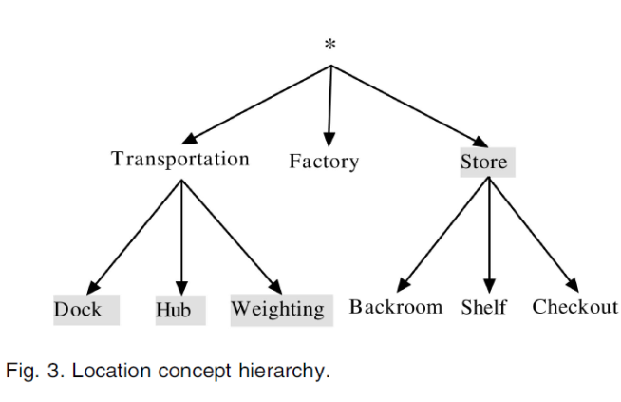
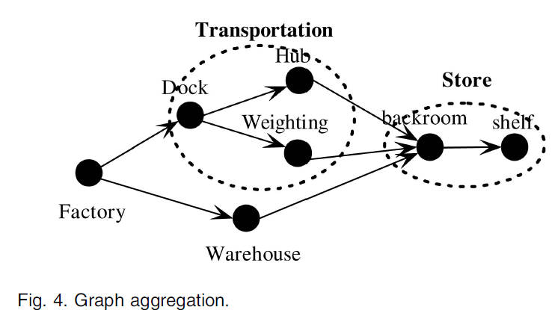
RFID Cube
Movement Graph Aggregation
  Location Aggregation
  Factory->Dock->Hub->Backroom->shelf
  Factory ->Transportation -> Store
  Factory -> Store.
  Edge Aggregation Semantics
  gid list for the edge (Factory, Store): Intersect the gid lists of all outgoing edges from the node Factory with the incoming edges to Store;
  gid list for the edge (Transportation, Store): union the gid lists of the edges (Hub, Store) and (Weighting, Store).

Slide 33
RFID Cube Continue…
Cube Structure
  Fact table
  (from, to, t_start, t_end, d₁, d₂, . . . , d_{k}: gid_list: measure list)
  Measure
  average temperature, total weight, or count
  use the gid list to quickly retrieve those paths that match a given slice, dice, or path selection query at any level of abstraction
  No need to access path database if it’s already precomputed
  If not precomputed: use the aggregated cells to quickly determine the list of relevant gids and retrieve the corresponding paths to compute the measure on the fly.
  RFID Cuboids
  Path aggregation is used to collapse uninteresting locations,
  and item aggregation is used to group-related items.
  Cells in a movement graph RFIDcuboids group both items, and edges that share the same values at the RFID-cuboid abstraction level.

Slide 34
RFID Cube Continue…
Cube Computation
  Partition based Aggregation
    Aggregate each partition of the graph independently
  Path prefix tree
    Next slide
  Cuboid materialization
  done by traversing each prefix tree, one branch at a time, and generating all possible edges from the branch
  All the cells involving these edges are then updated to include the gids associated with the edge and their measures adjusted.
  Also do aggregation of RFIDcuboids that include only item dimensions

Slide 35
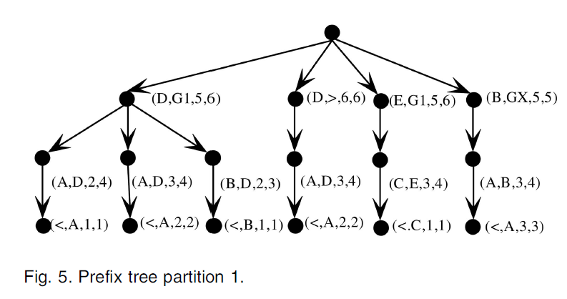

Slide 36
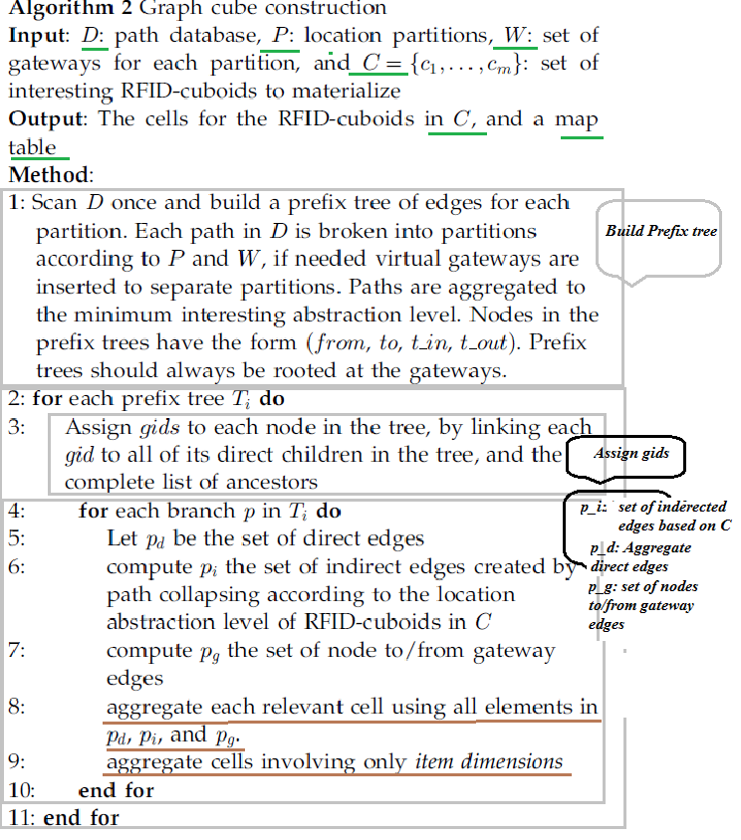

Slide 37
Outline
Motivation
Contribution
RFID Data
Gateway-Based Movement Graph
Data Compression
Movement Graph Partitioning
Storage Model
Materialization Strategy
RFID Cube
Experimental Evaluation
Conclusions

Slide 38
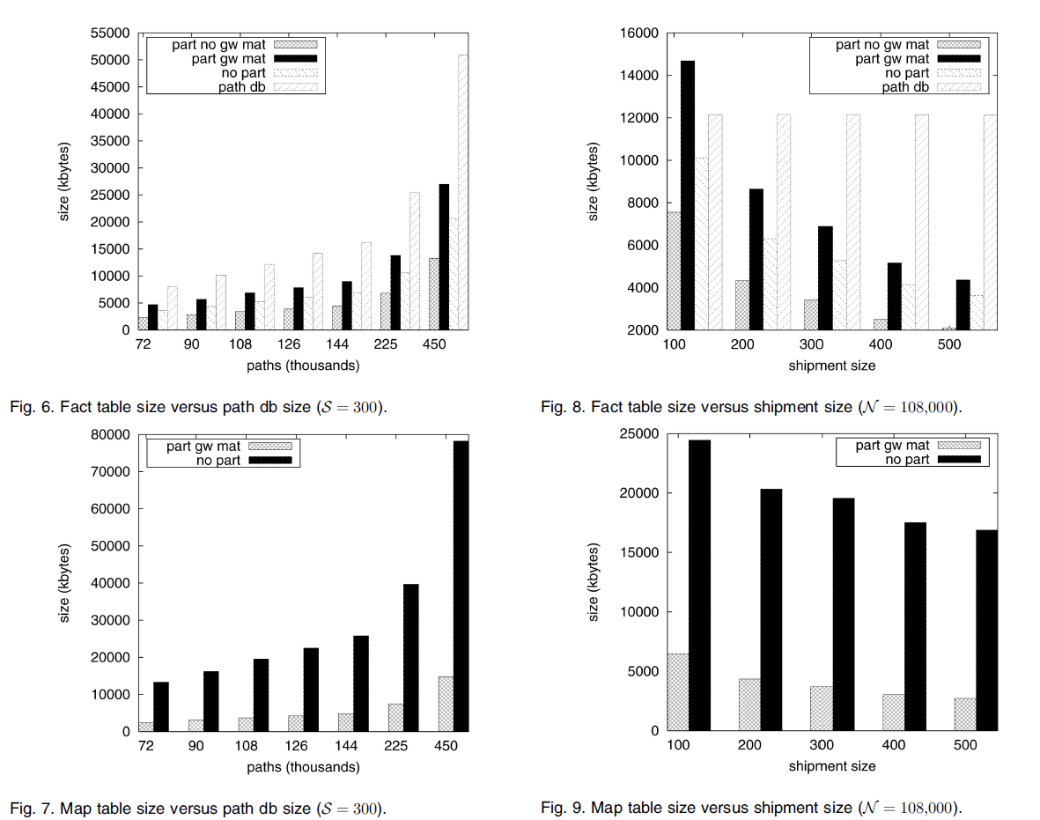
Experimental Evaluation

Slide 39
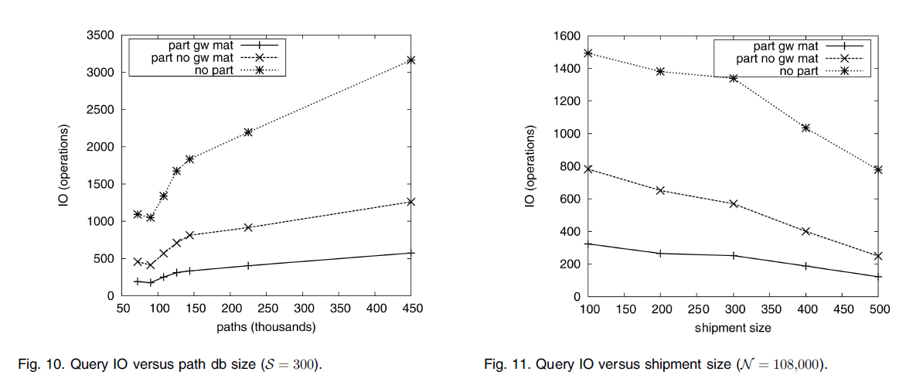
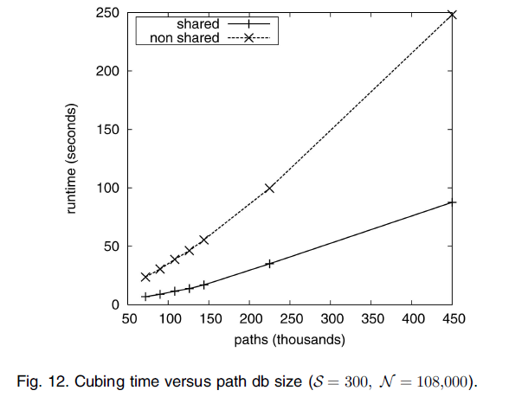
Experimental Evaluation Continue…

Slide 40
Outline
Motivation
Contribution
RFID Data
Gateway-Based Movement Graph
Data Compression
Movement Graph Partitioning
Storage Model
Materialization Strategy
RFID Cube
Experimental Evaluation
Conclusions

Slide 41
Conclusion
Presented a new gateway based movement graph model for warehousing massive transportation based RFID datasets
sets up a solid foundation for modeling RFID data and facilitates efficient and effective RFID data compression, data cleaning, multidimensional data aggregation, query processing, and data mining

Slide 42
Thank You

